Slide 1
An NSS Audio-Visual
Library Presentation
How Do You Clean Up After The Millionth Visitor?
Maintaining Commercial Caves.
Prepared by Pat Jablonski, NSS #26924
(1989)
S204 81 Slides 1/20/2021

Slide 2
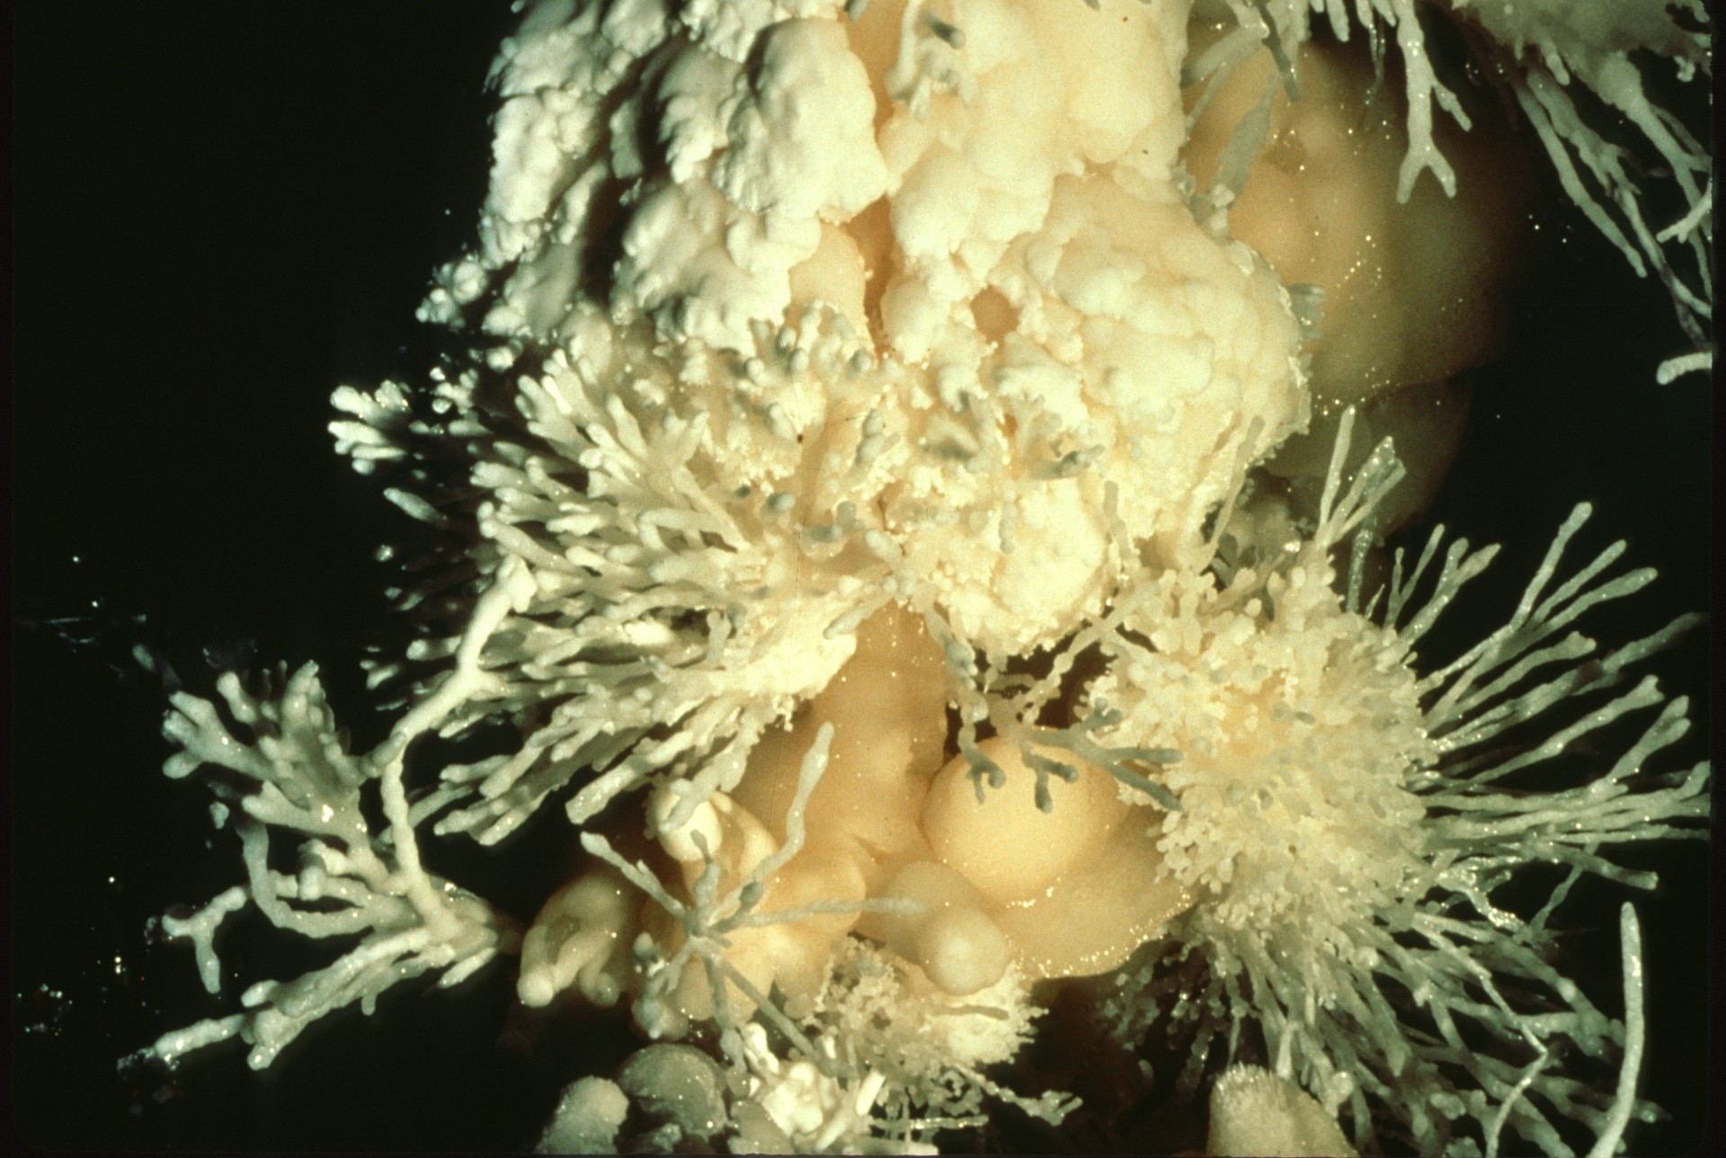
Notes:
Caves are secret places hidden from man for eons of time…infrequently, caves and men come together, and often their union is not in the best interest of the cave and its fragile environment. Once man enters a cave, it is altered forever. Even the most careful of visitors causes irreversible changes.

Slide 3
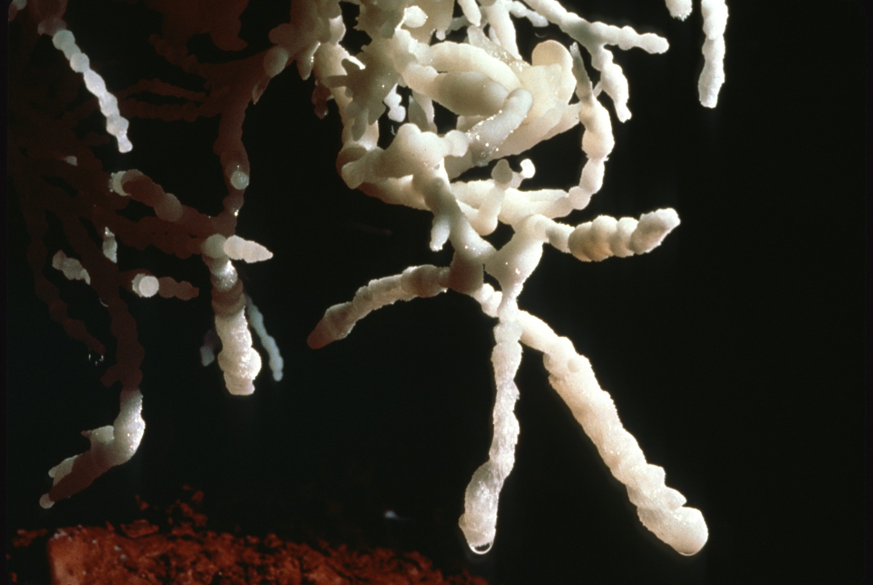
Notes:
It would be nice, if in the beginning, we could control deterioration and damage of these places of pristine beauty and wonder. But in most cases this has not occurred. The object of this slide program is to show you some of the restoration projects being done in both privately-owned and government-administered show caves, to show what can be done to preserve our caves as best we know how with our present technology.

Slide 4
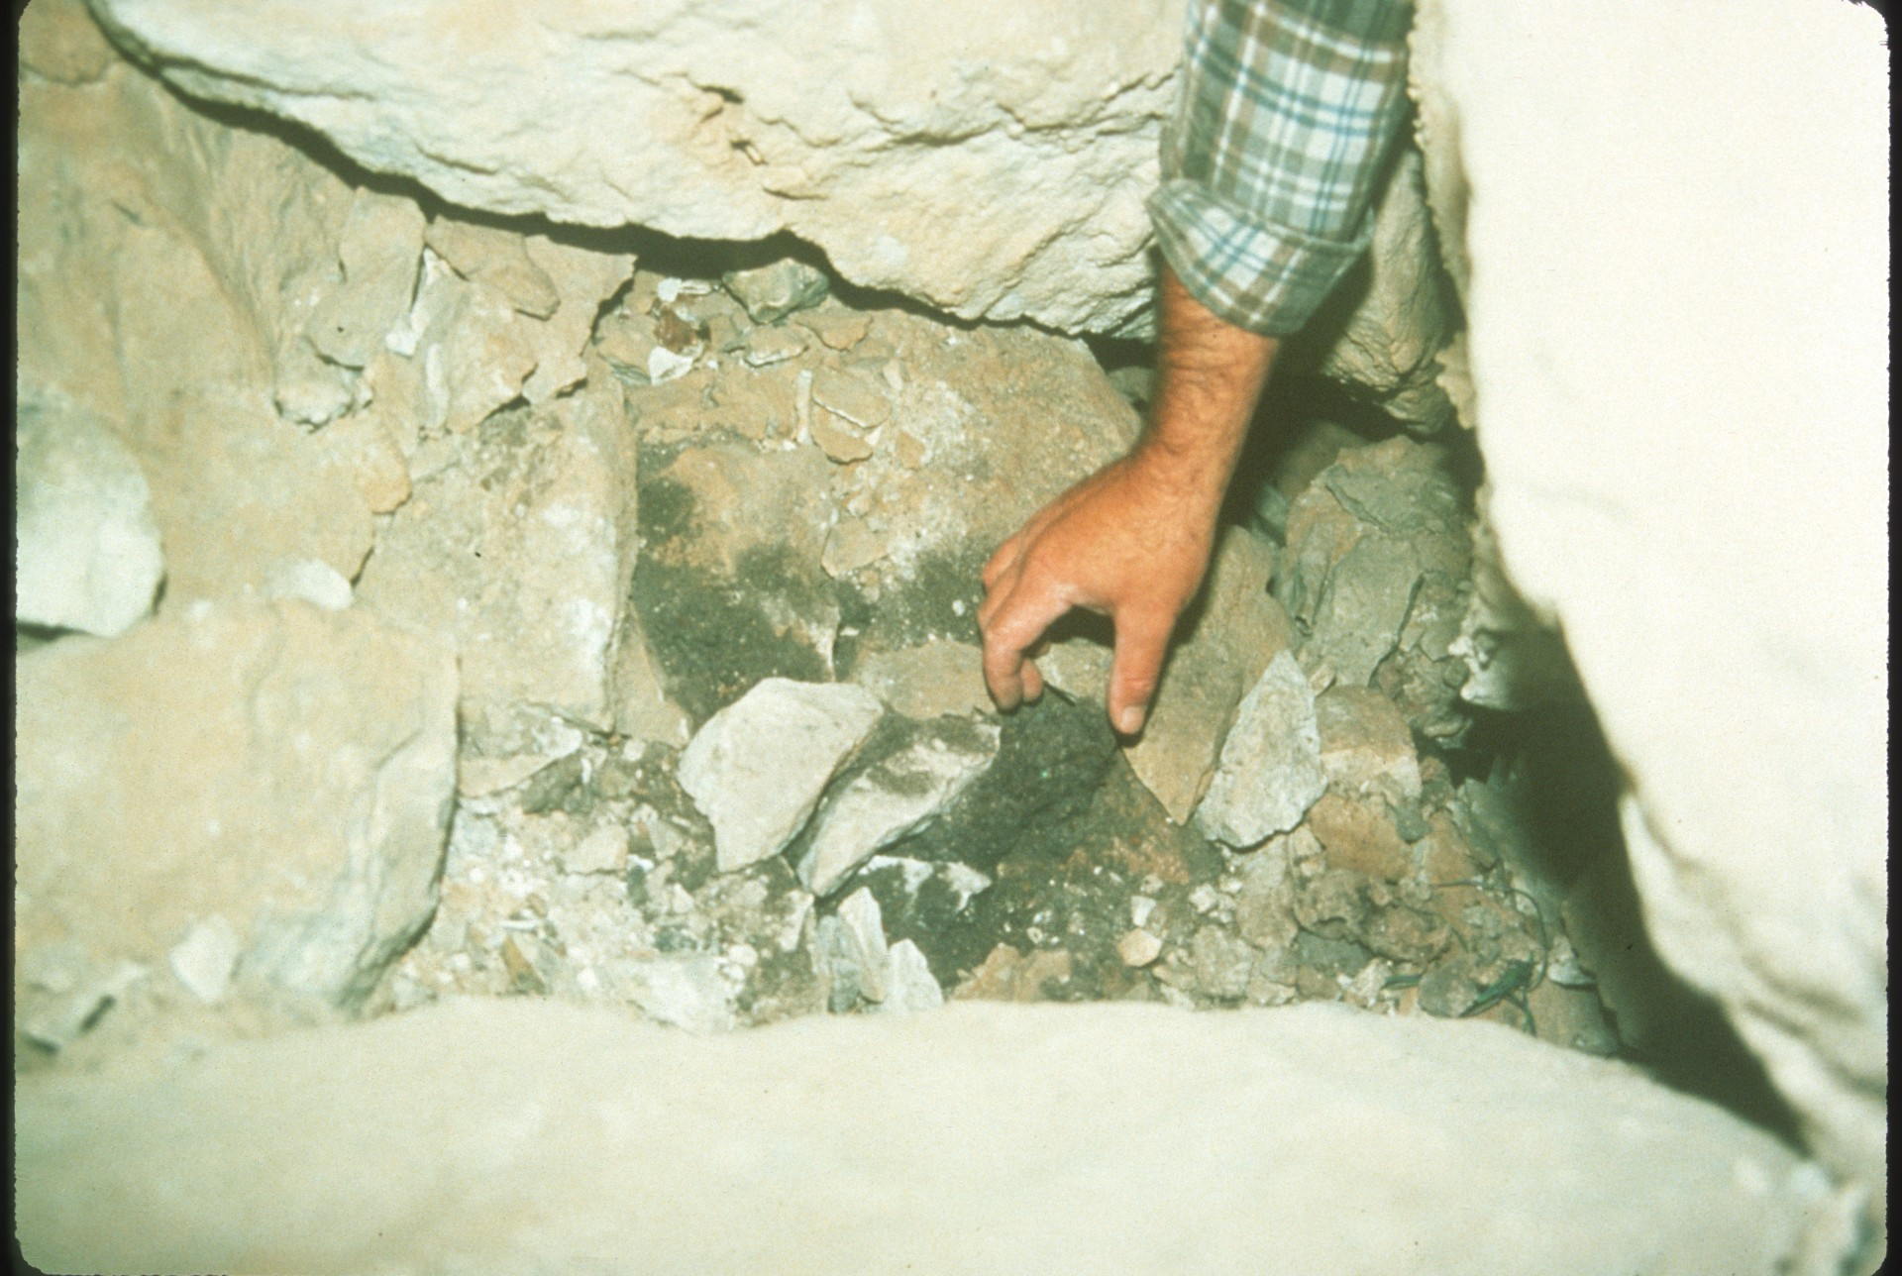
Notes:
Let us look at such common problems as lint, litter…

Slide 5
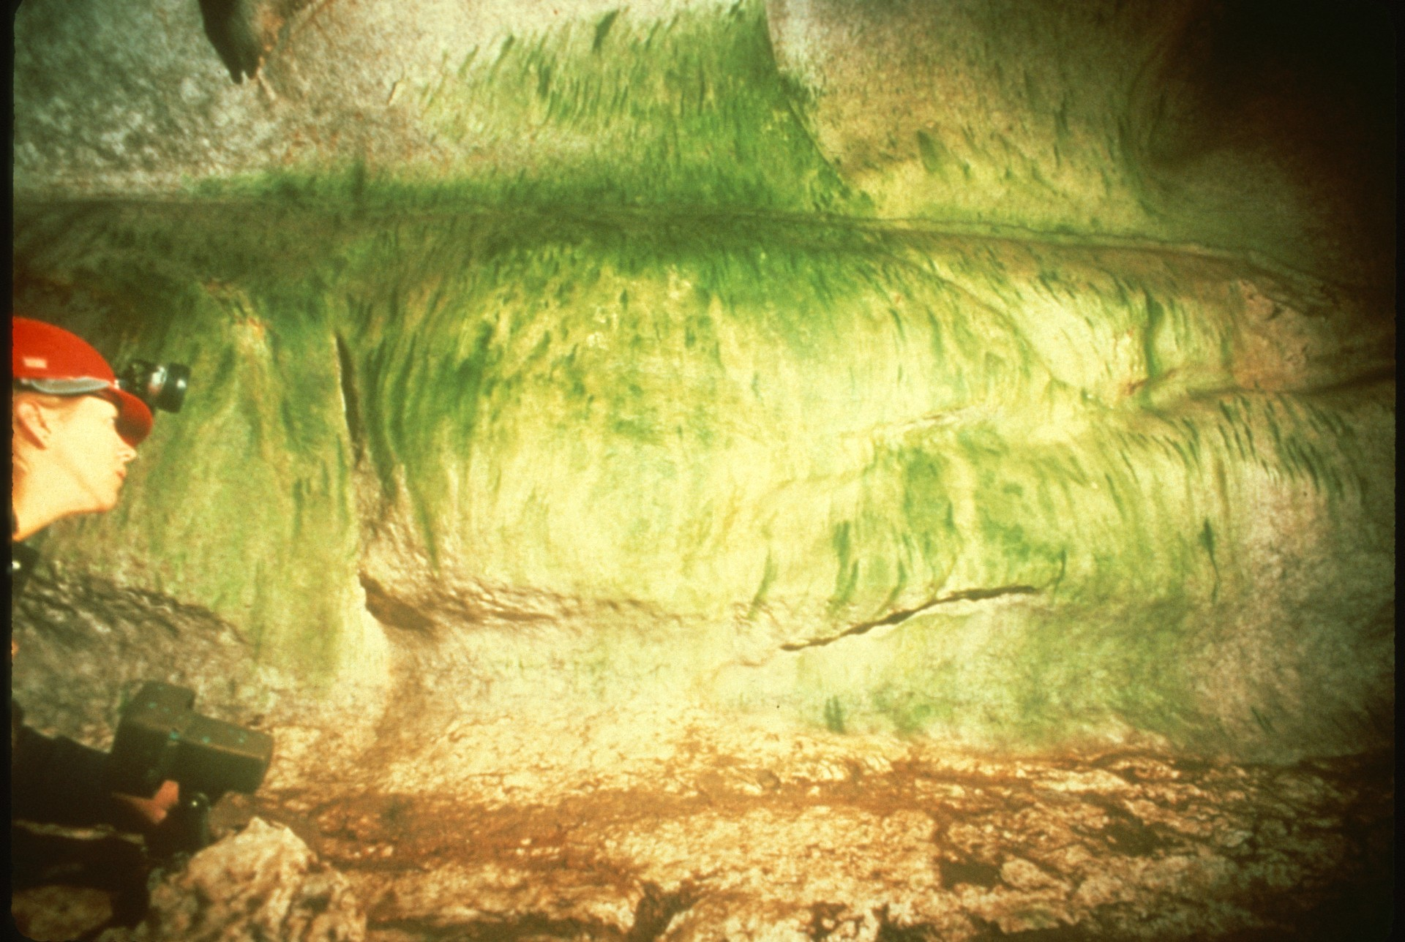
Notes:
…algae, …

Slide 6
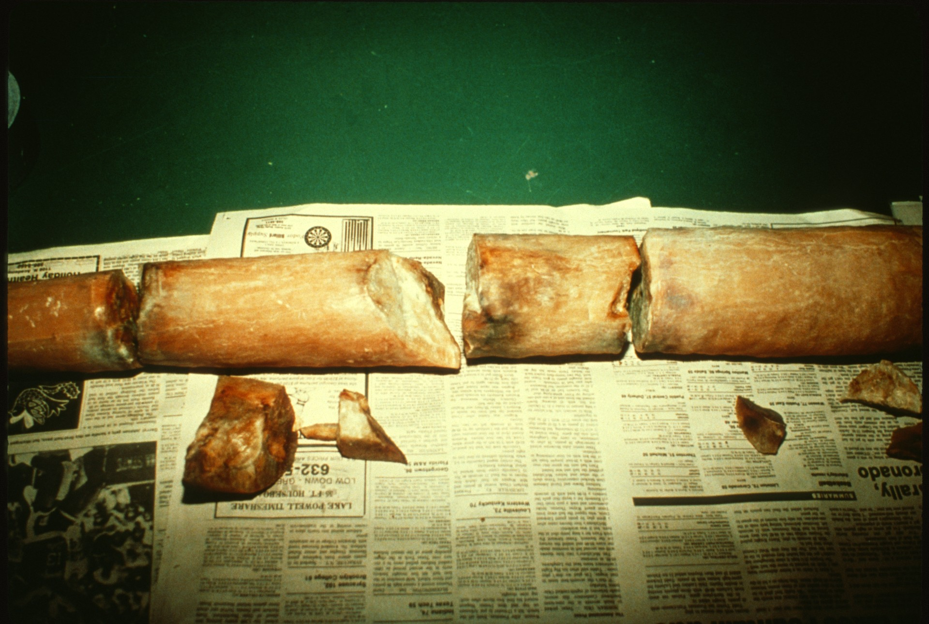
Notes:
… broken formations, …

Slide 7
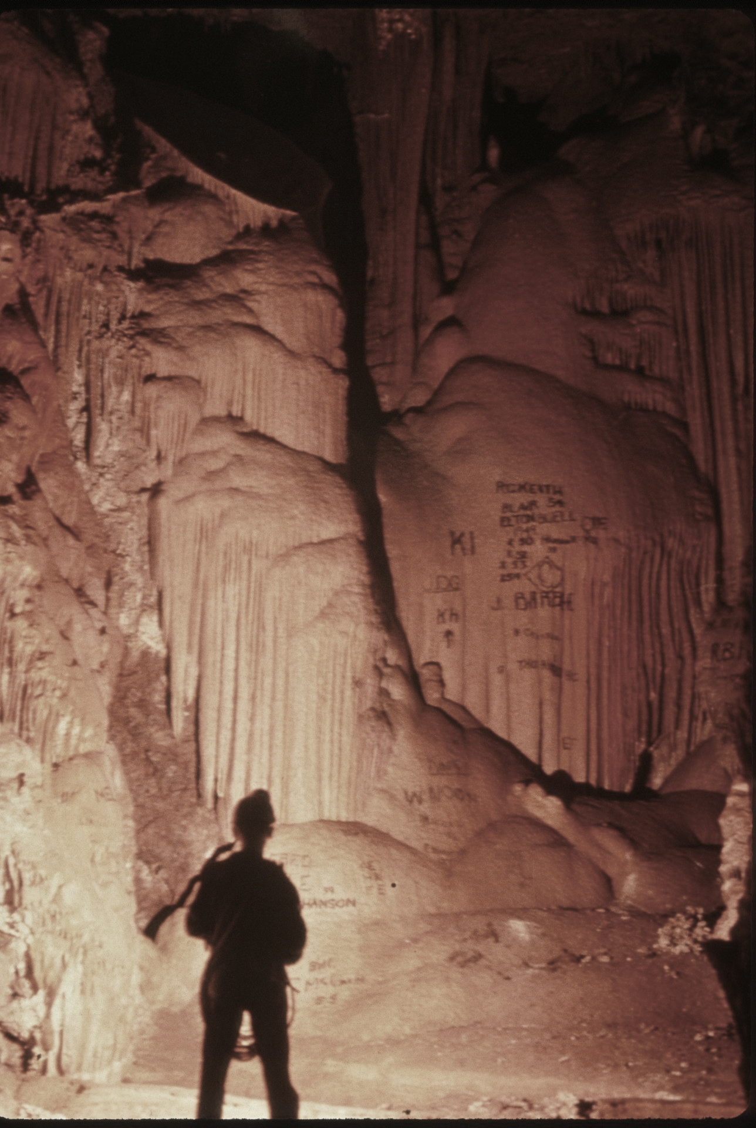
Notes:
… and graffiti.

Slide 8
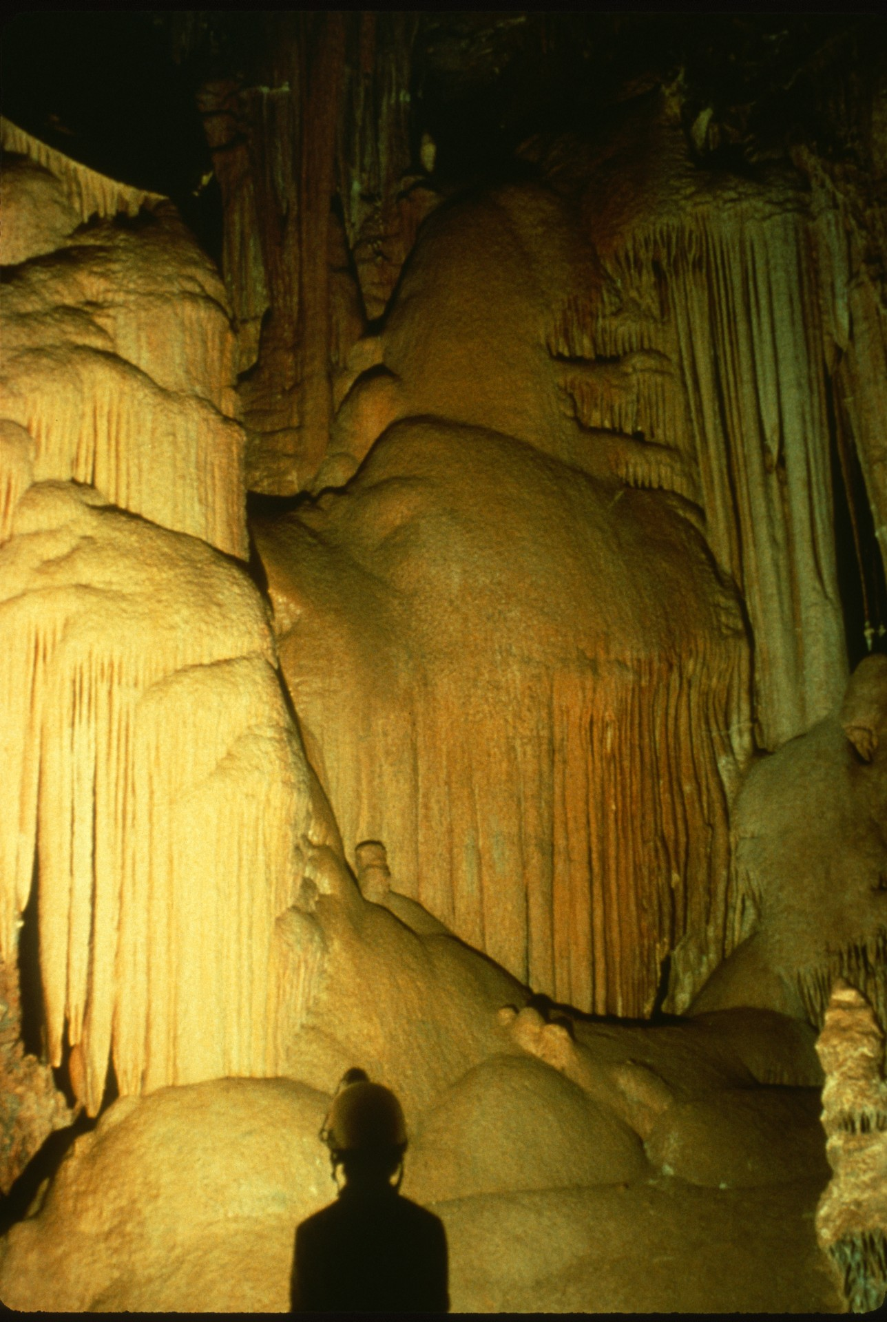
Notes:
This series of slides shows before and after shots of graffiti problems and restoration work at Onyx Cave, Arizona. (After)

Slide 9
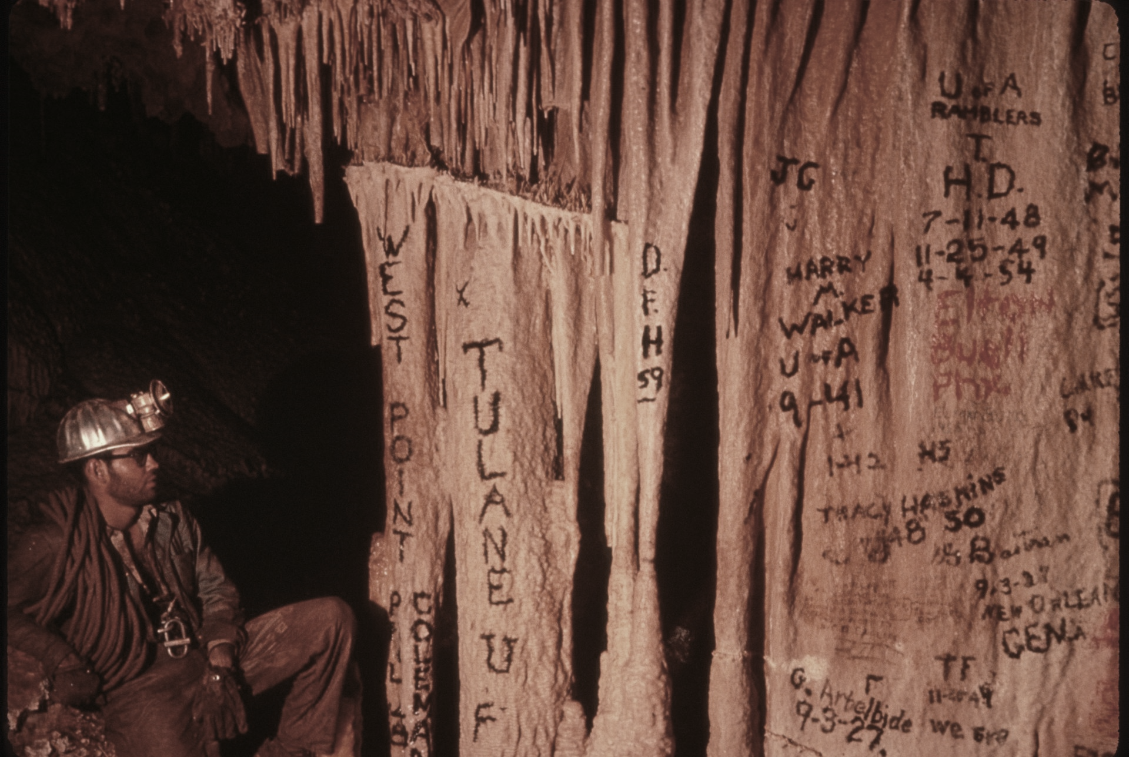
Notes:
(Before)

Slide 10
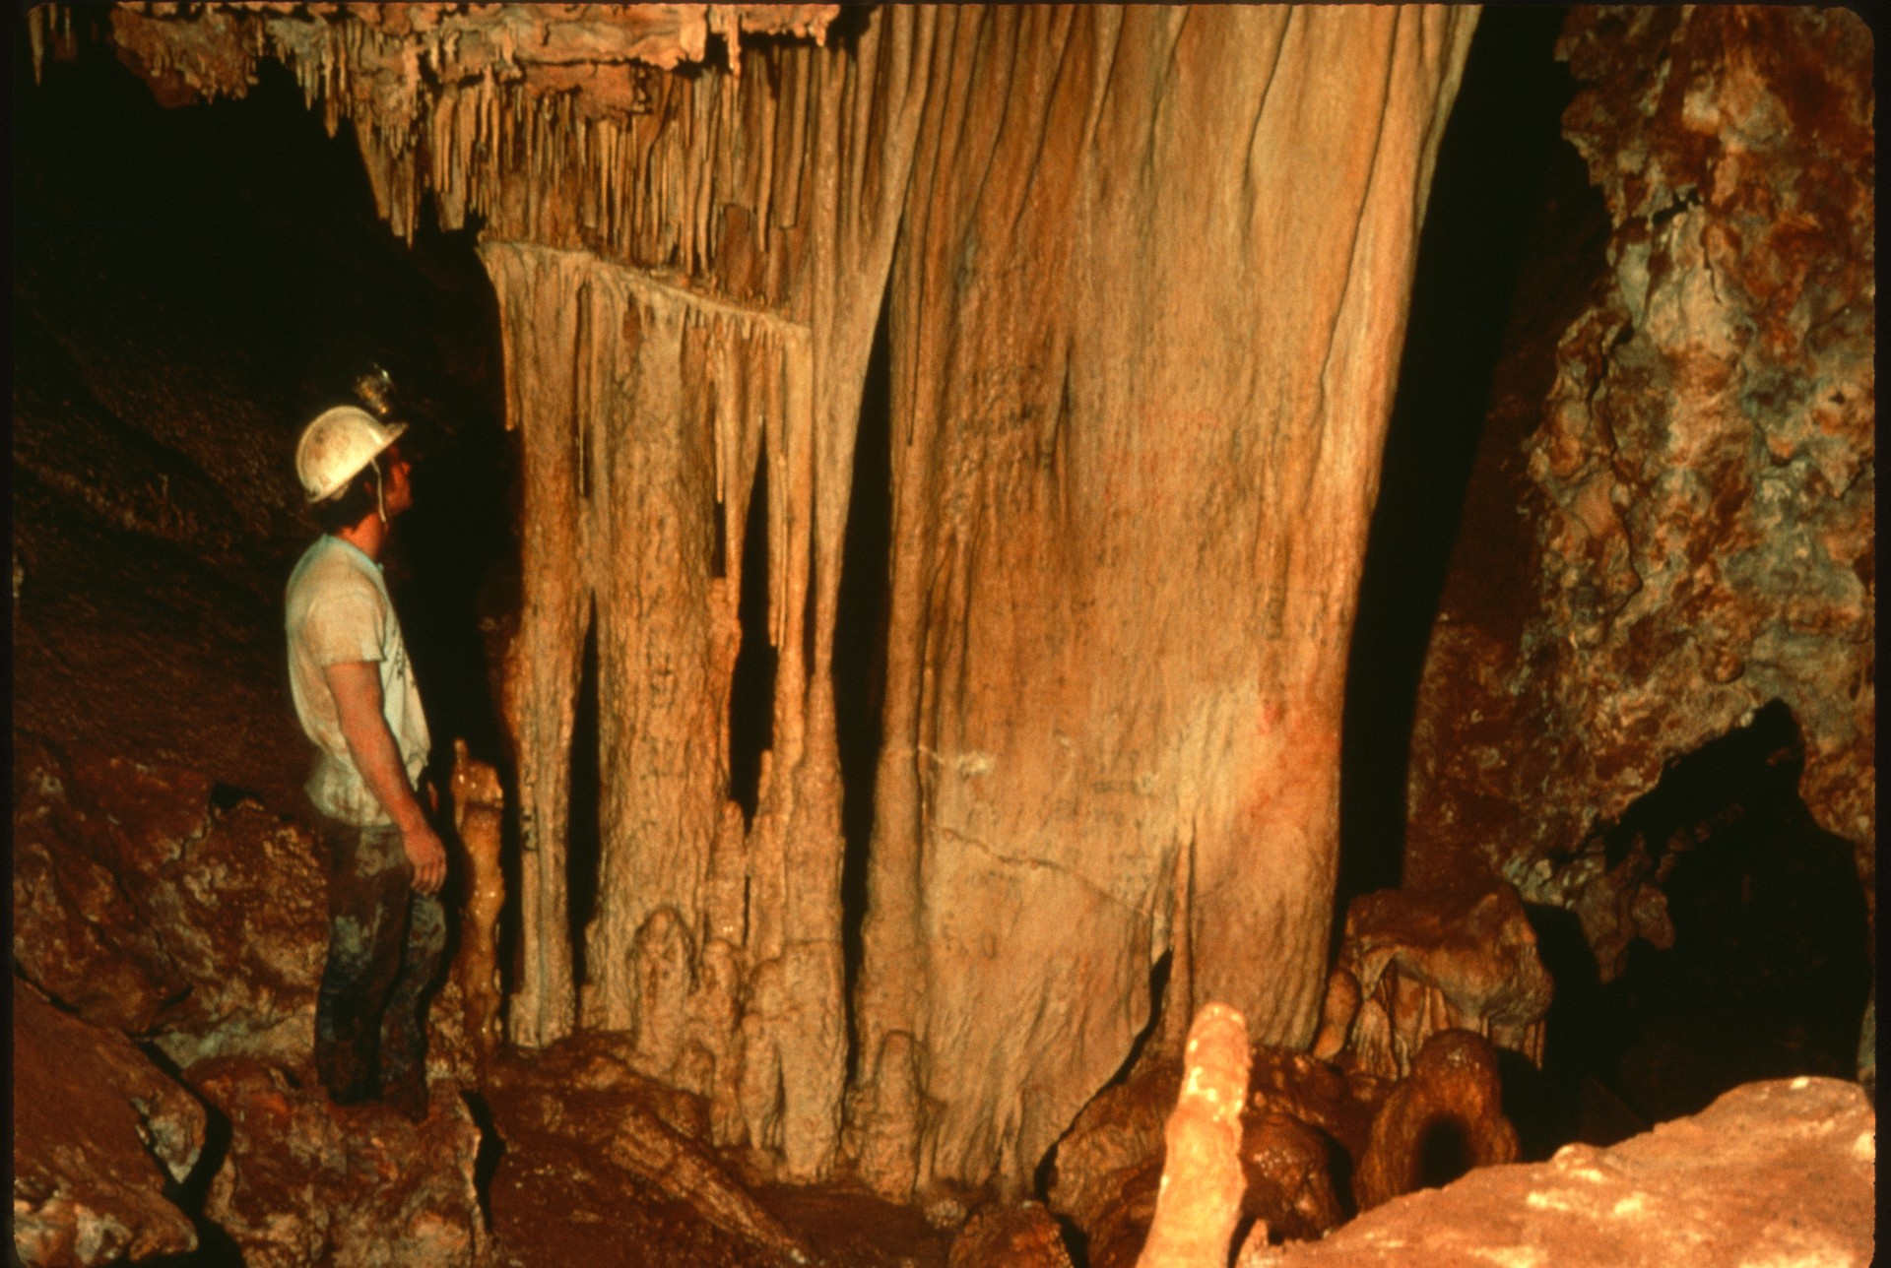
Notes:
(After)

Slide 11
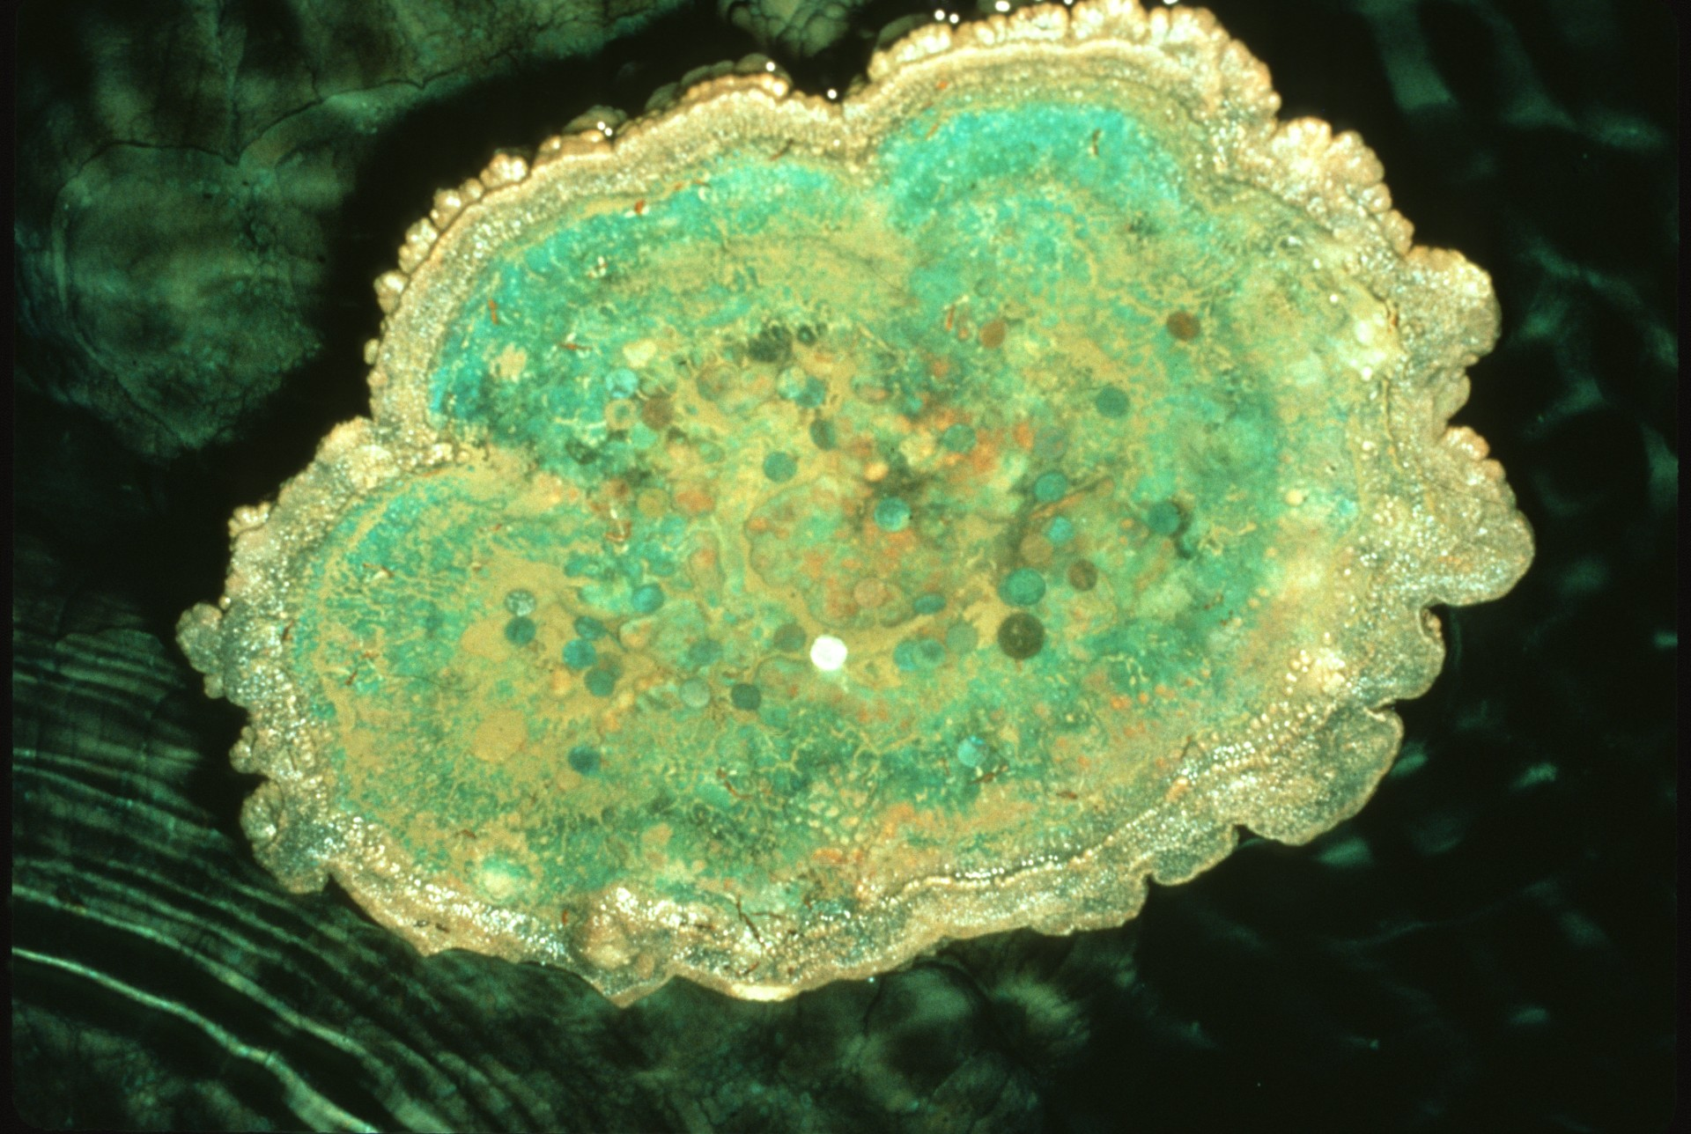
Notes:
Another common problem is coin tossing, which causes staining of formations and discolored water. Coins damage the water by introducing organic [sic, more likely minerals] which can reduce the oxygen level in the water and possibly cause stagnation.

Slide 12
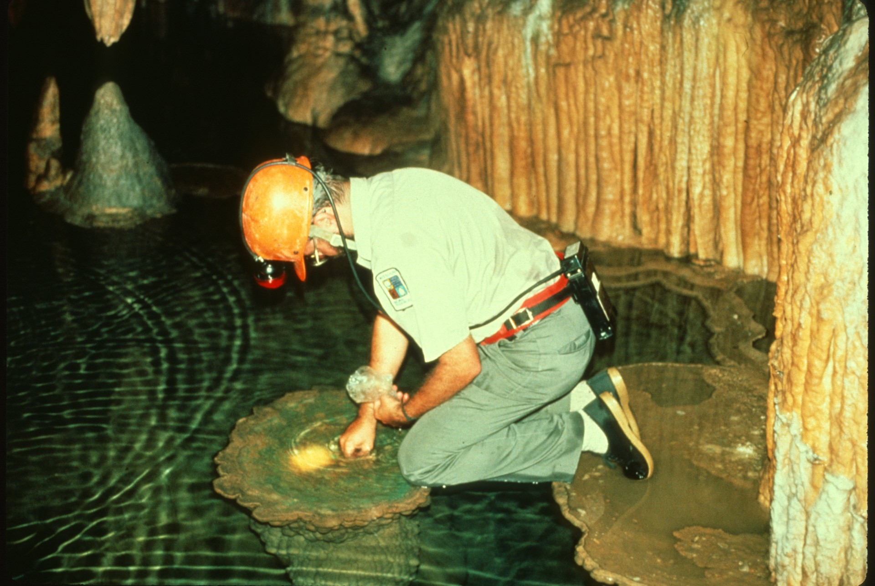
Notes:
The collection of coins in Onondaga Cave in Missouri is done in a variety of ways: hand collecting…

Slide 13
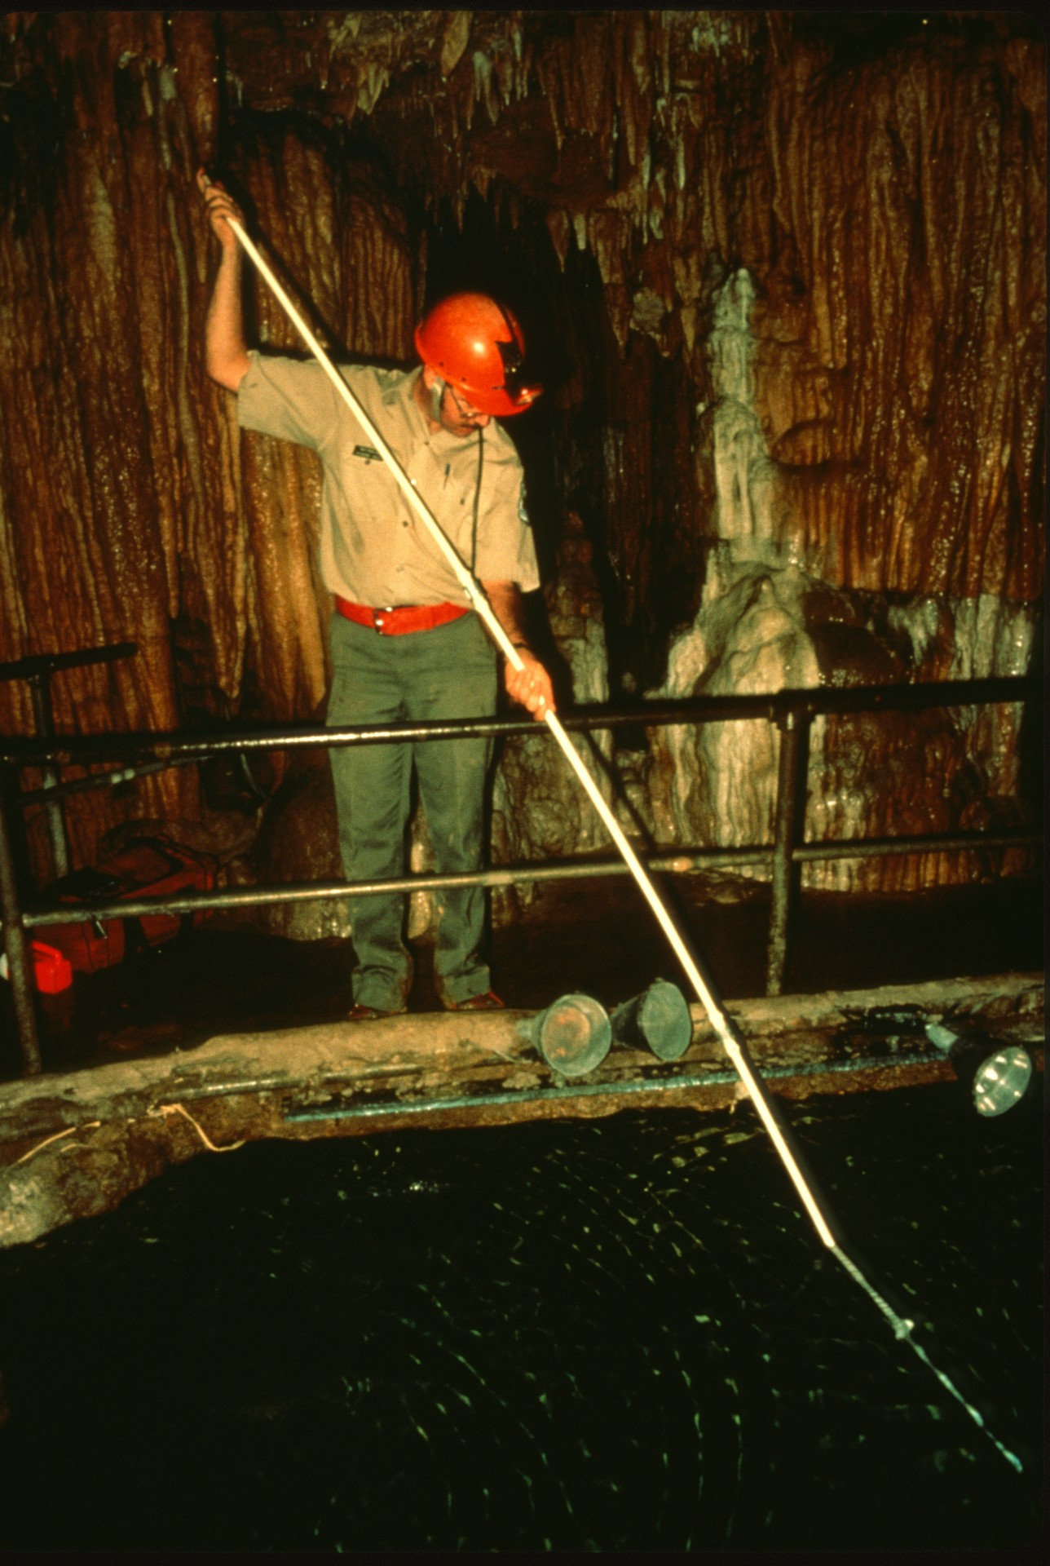
Notes:
… using a spoon on the end of a long stick, …

Slide 14
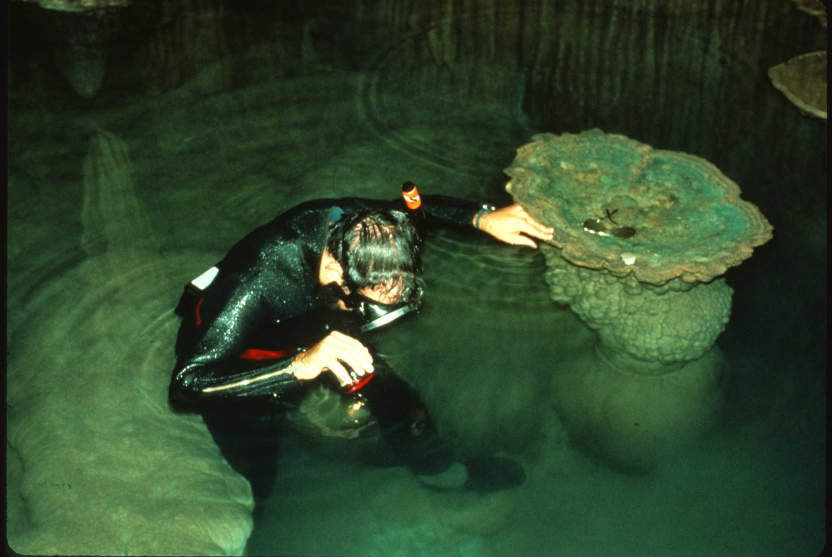
Notes:
… and in some instances, diving.

Slide 15
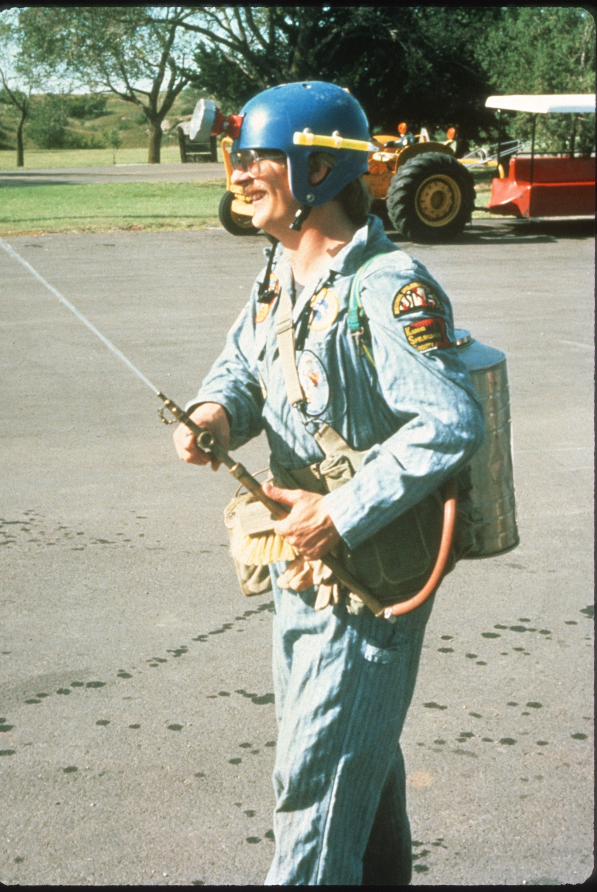
Notes:
Algae is a common problem at most caves. At Alabaster Cave in Oklahoma cavers tackle the problem using a portable spray unit and a mixture of water and bleach.

Slide 16
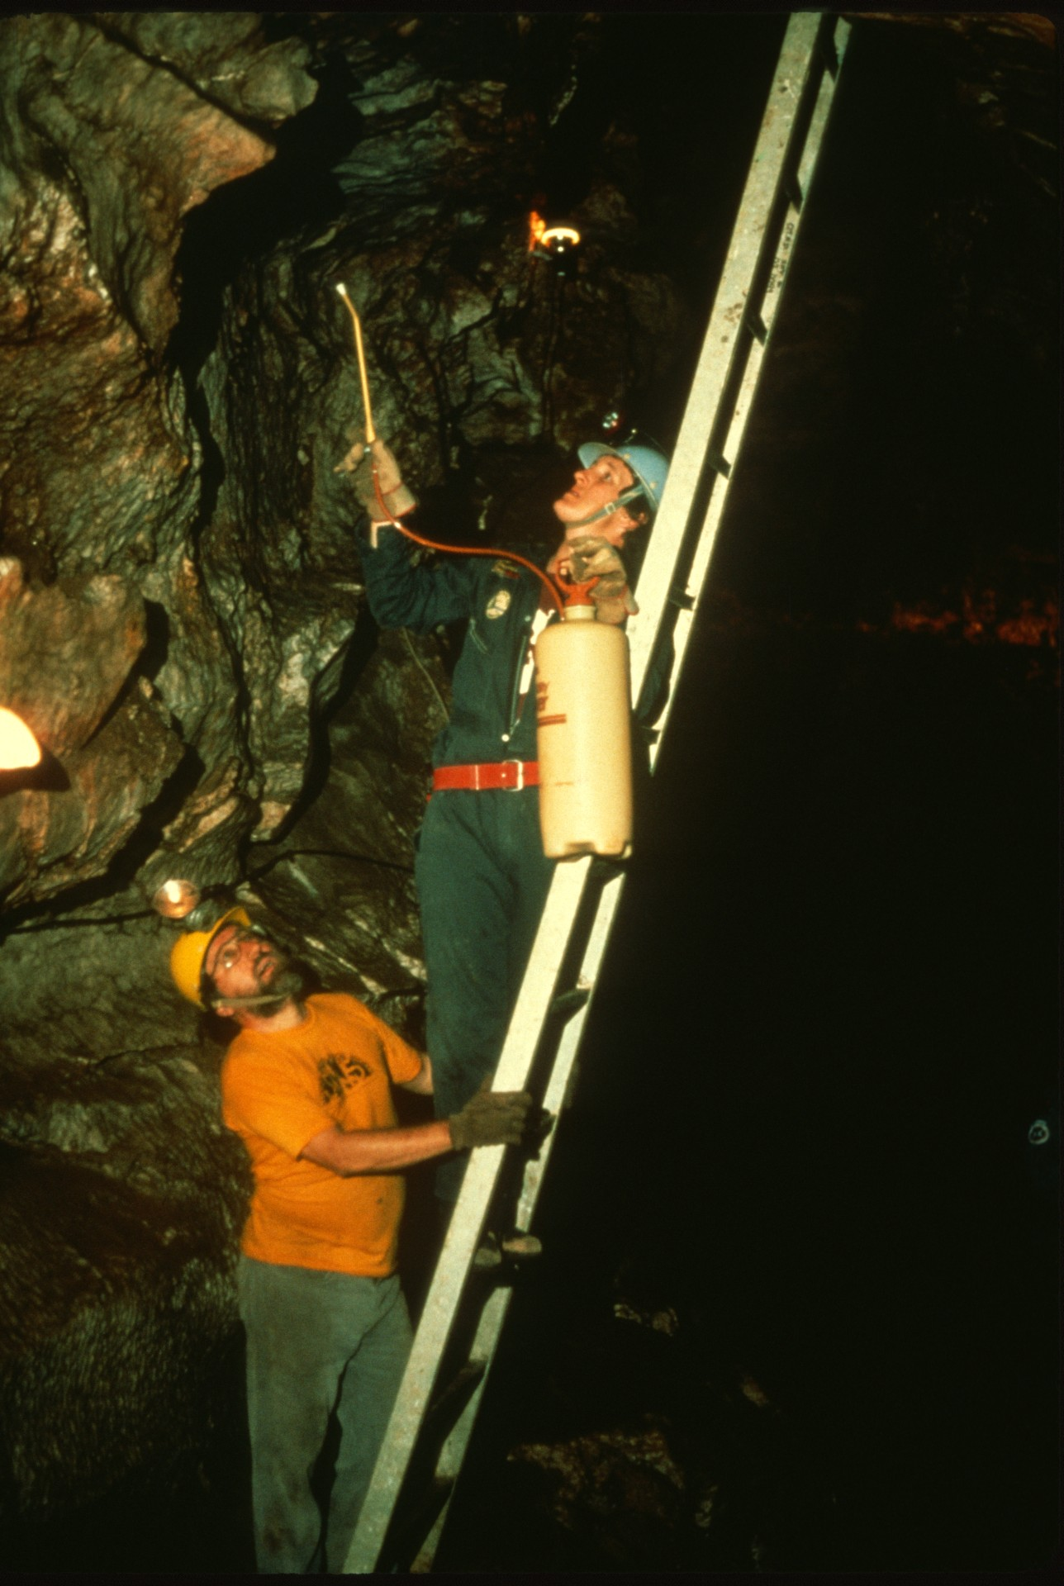
Notes:
In this photo, we see the cavers using the spray unit. It should be noted that the workers should always wear masks for protection from the bleach spray.

Slide 17
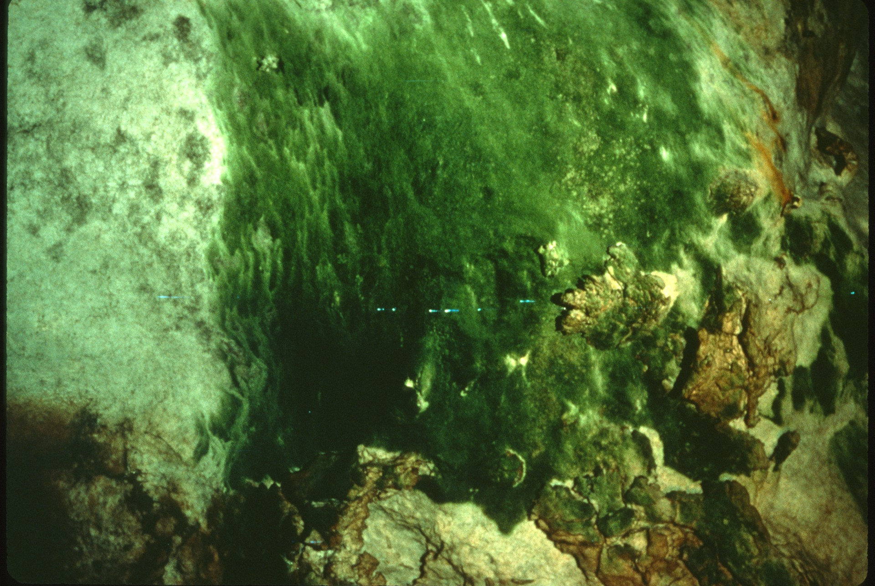
Notes:
(Before)

Slide 18
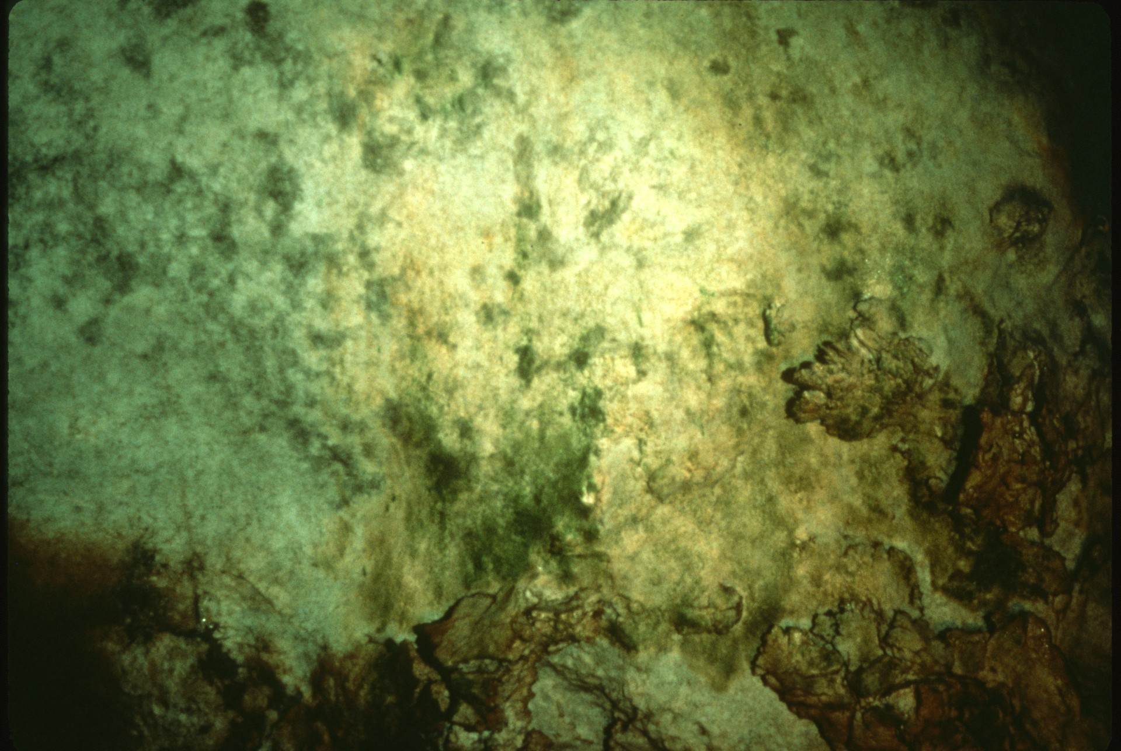
Notes:
After use of the bleach and some scraping.

Slide 19
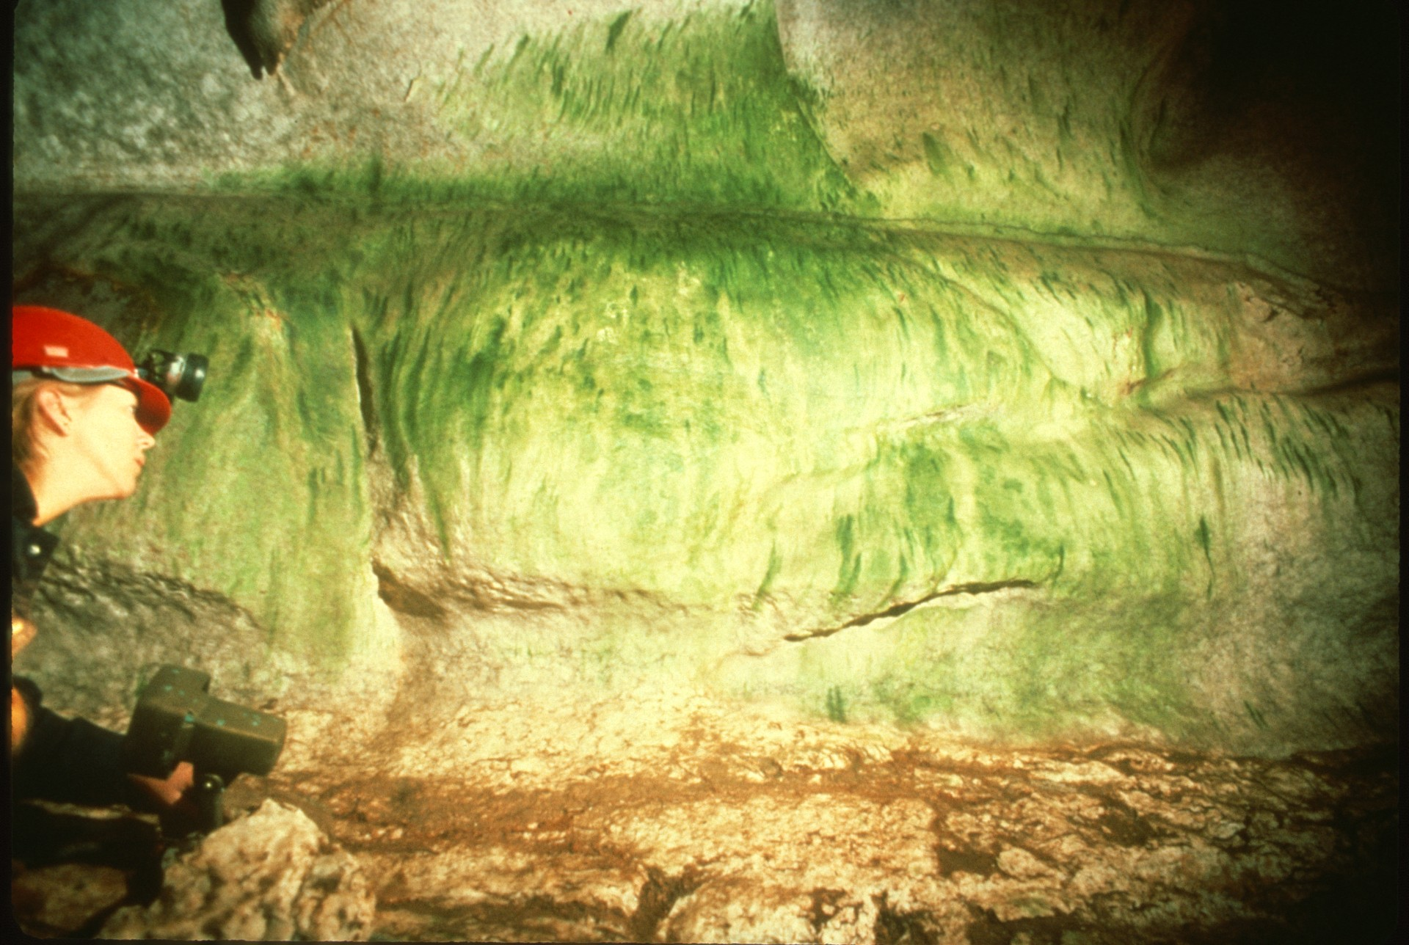
Notes:
(Before)

Slide 20
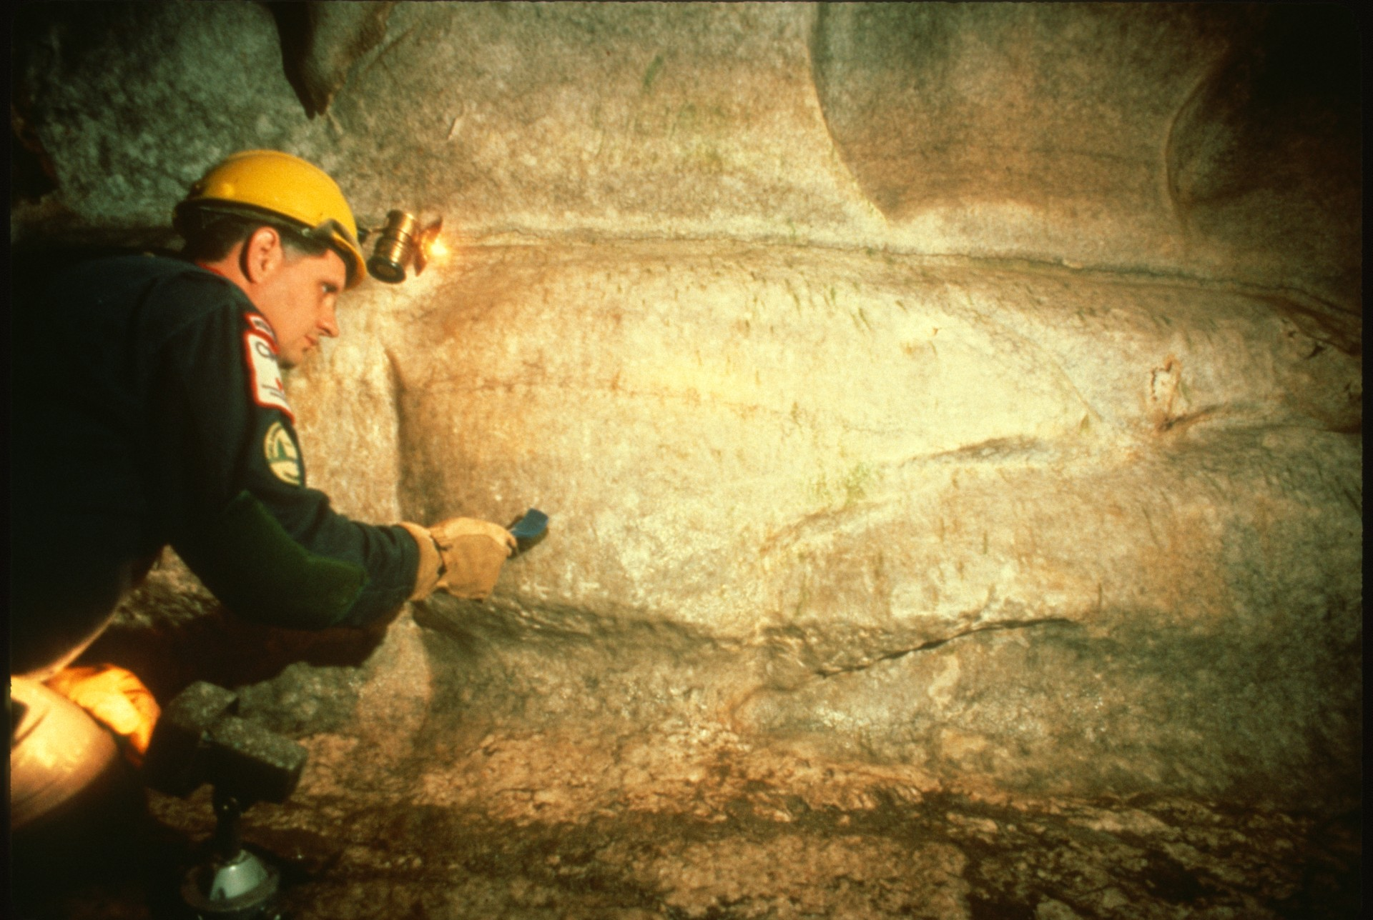
Notes:
After, with excellent results. The mixture of bleach to water will depend on the extent of algae.

Slide 21
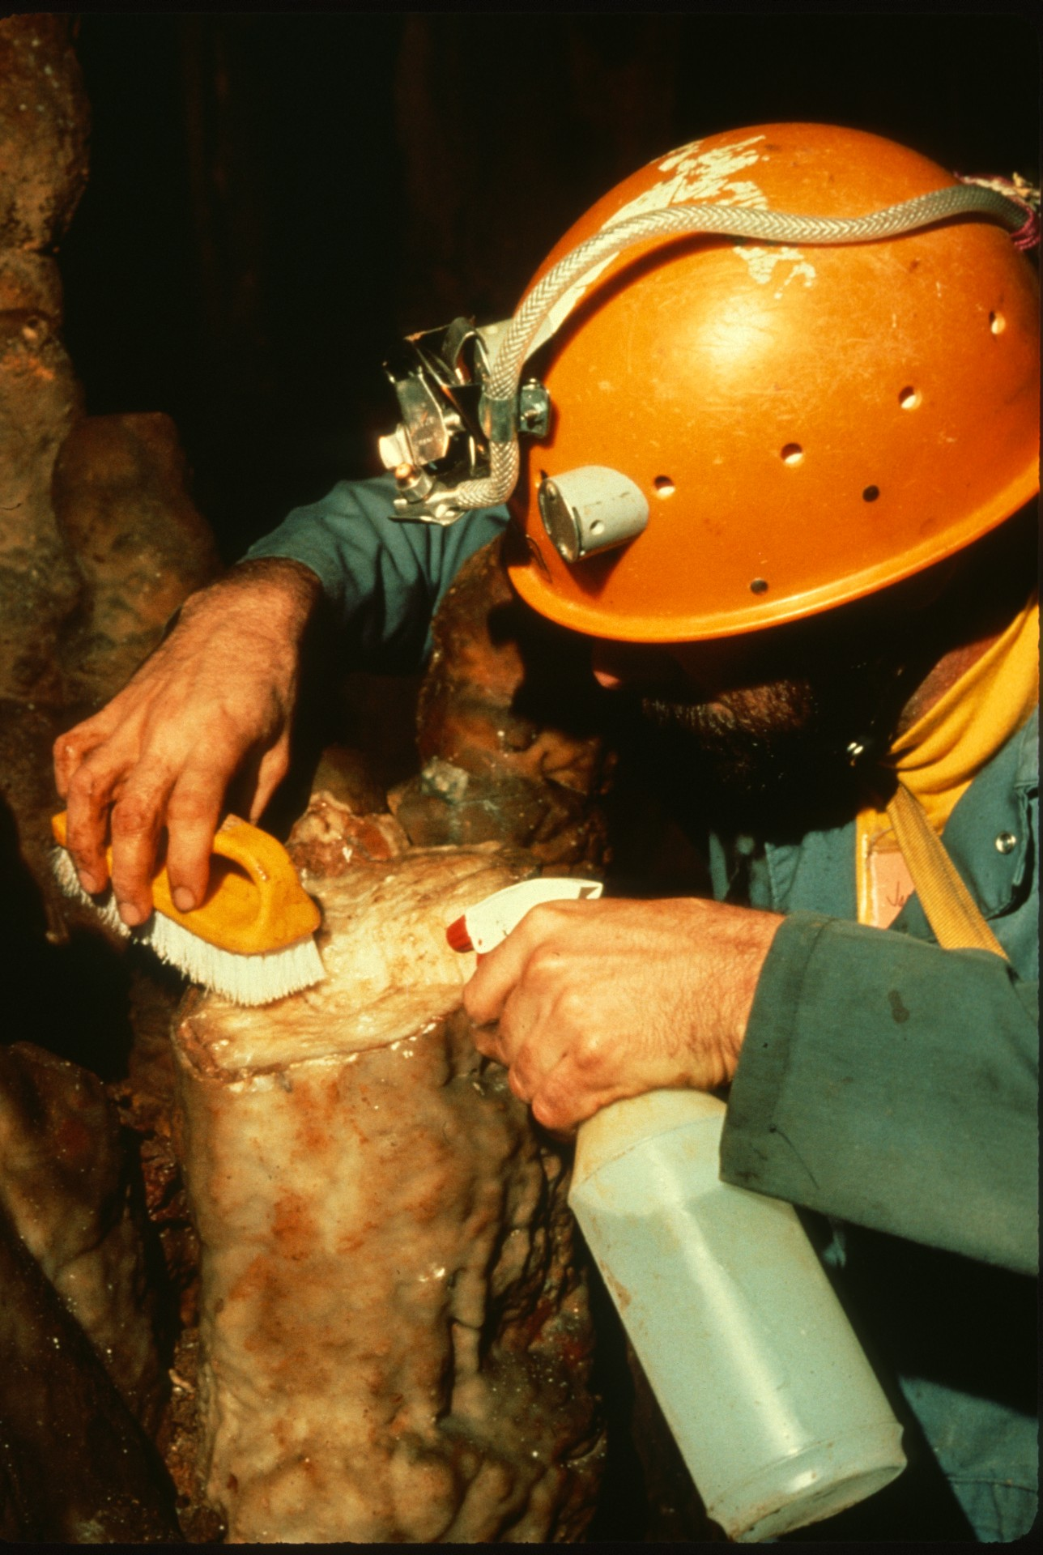
Notes:
We next move on to probably the most common of problems: Broken formations. In this series of photos taken at Fountain Cave, Virginia, we see workers repairing the formations using an epoxy mixture. This slide shows the base of the formation being prepared for the application of epoxy.

Slide 22
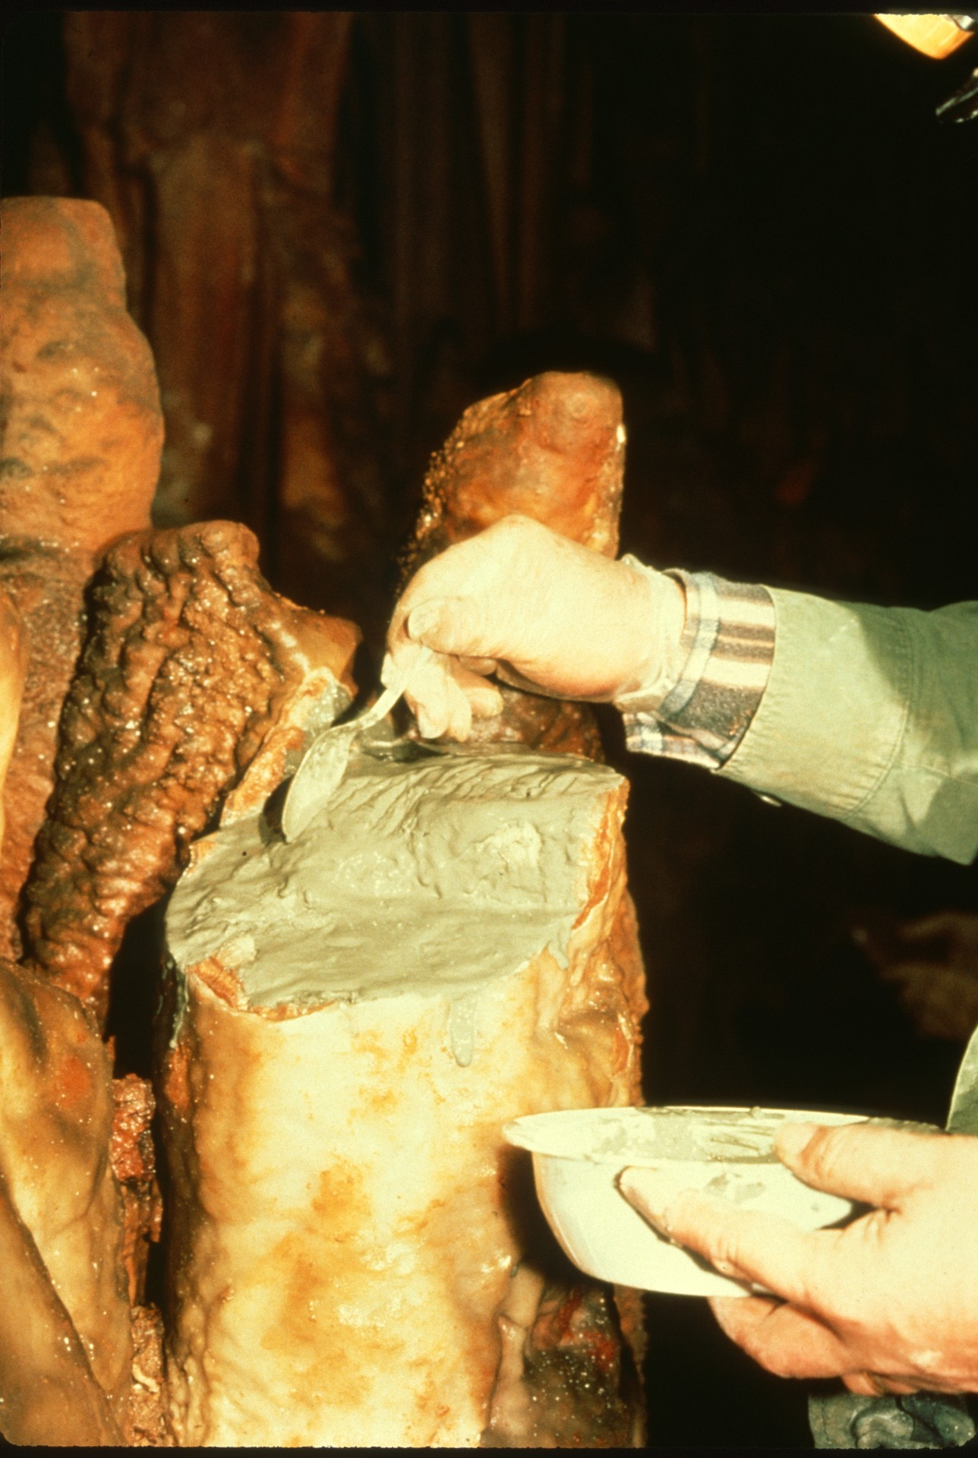
Notes:
Applying the epoxy.

Slide 23
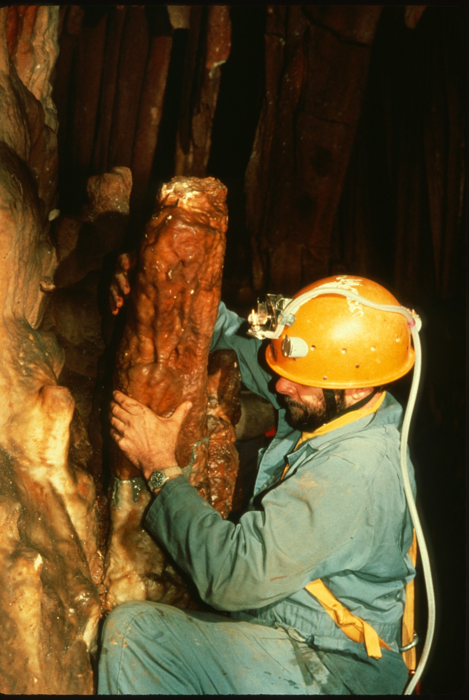
Notes:
Setting the broken piece into place.

Slide 24
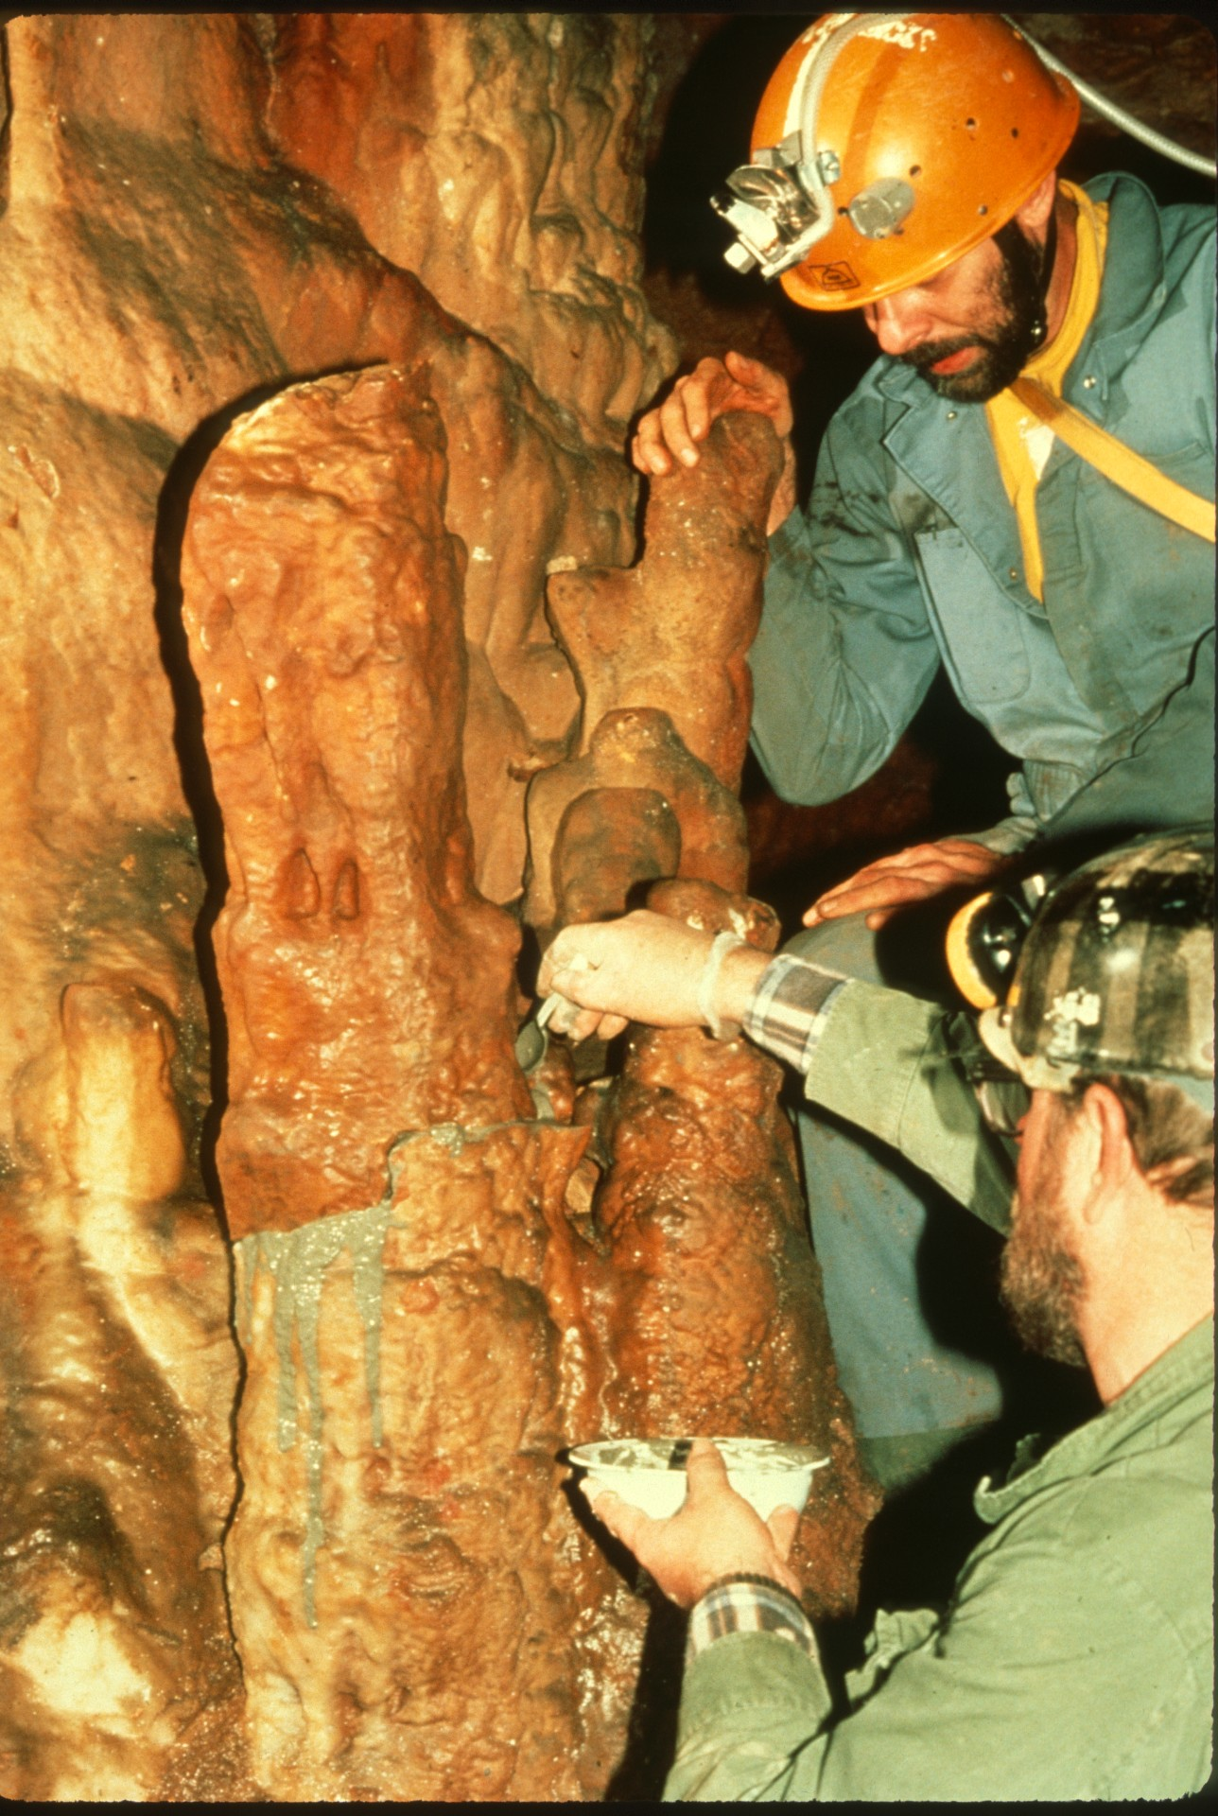
Notes:
Stabilizing it and performing some cosmetic touches.

Slide 25
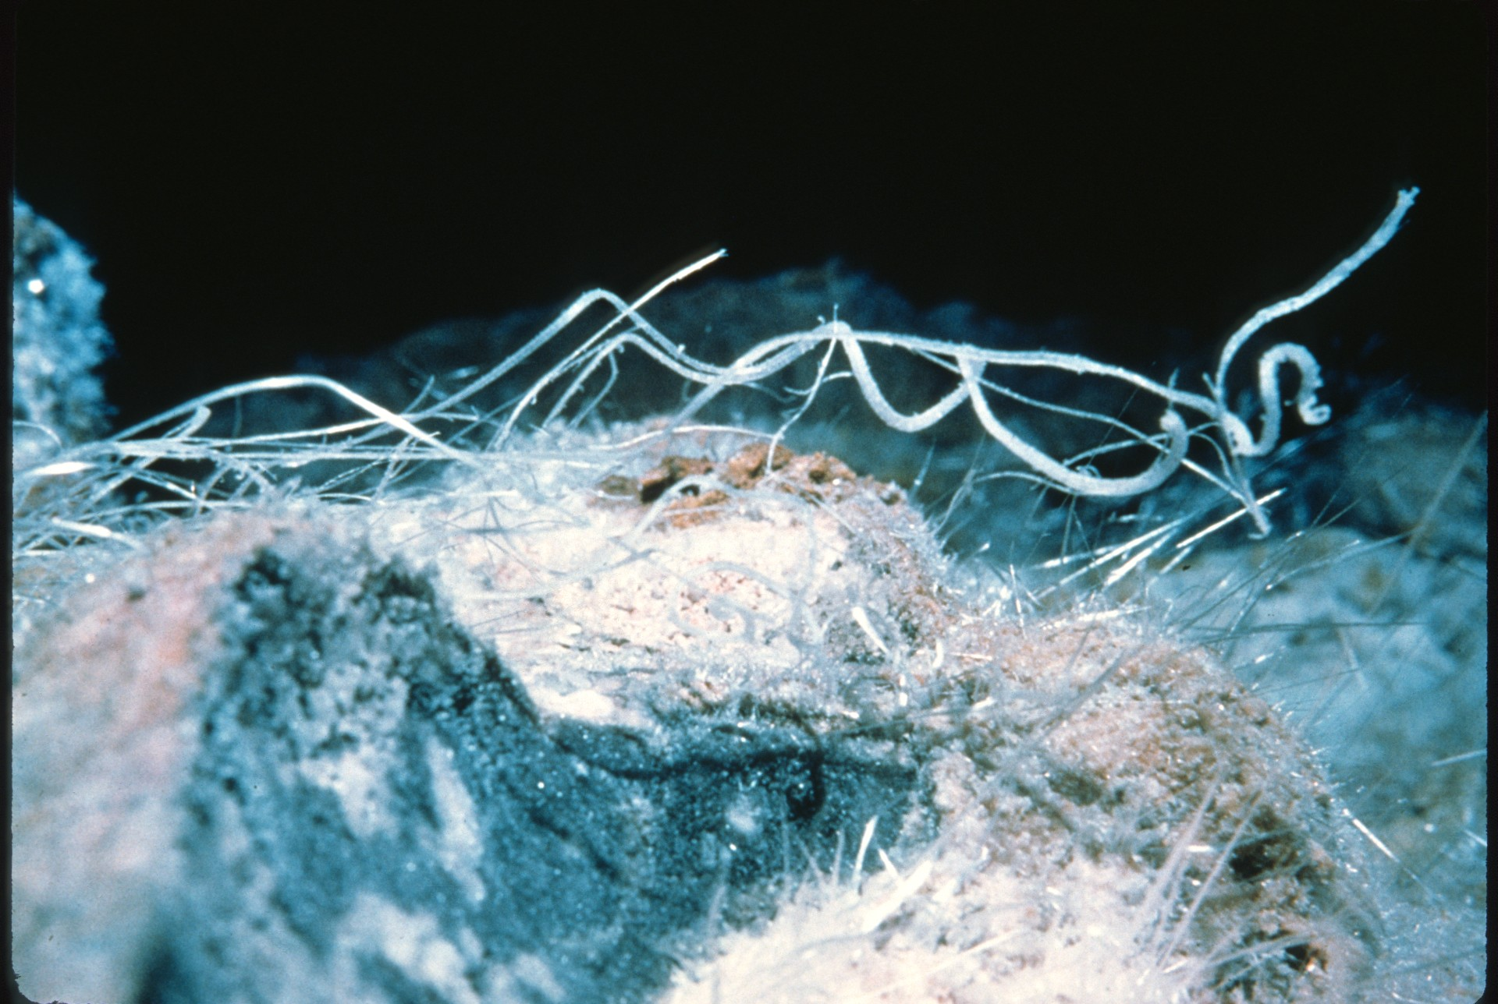
Notes:
Vandalism is prevalent in most caves. Even in those not open to the general public, we find vandalism. Here we are at Cottonwood Cave in New Mexico, viewing a beautiful gypsum cluster.

Slide 26
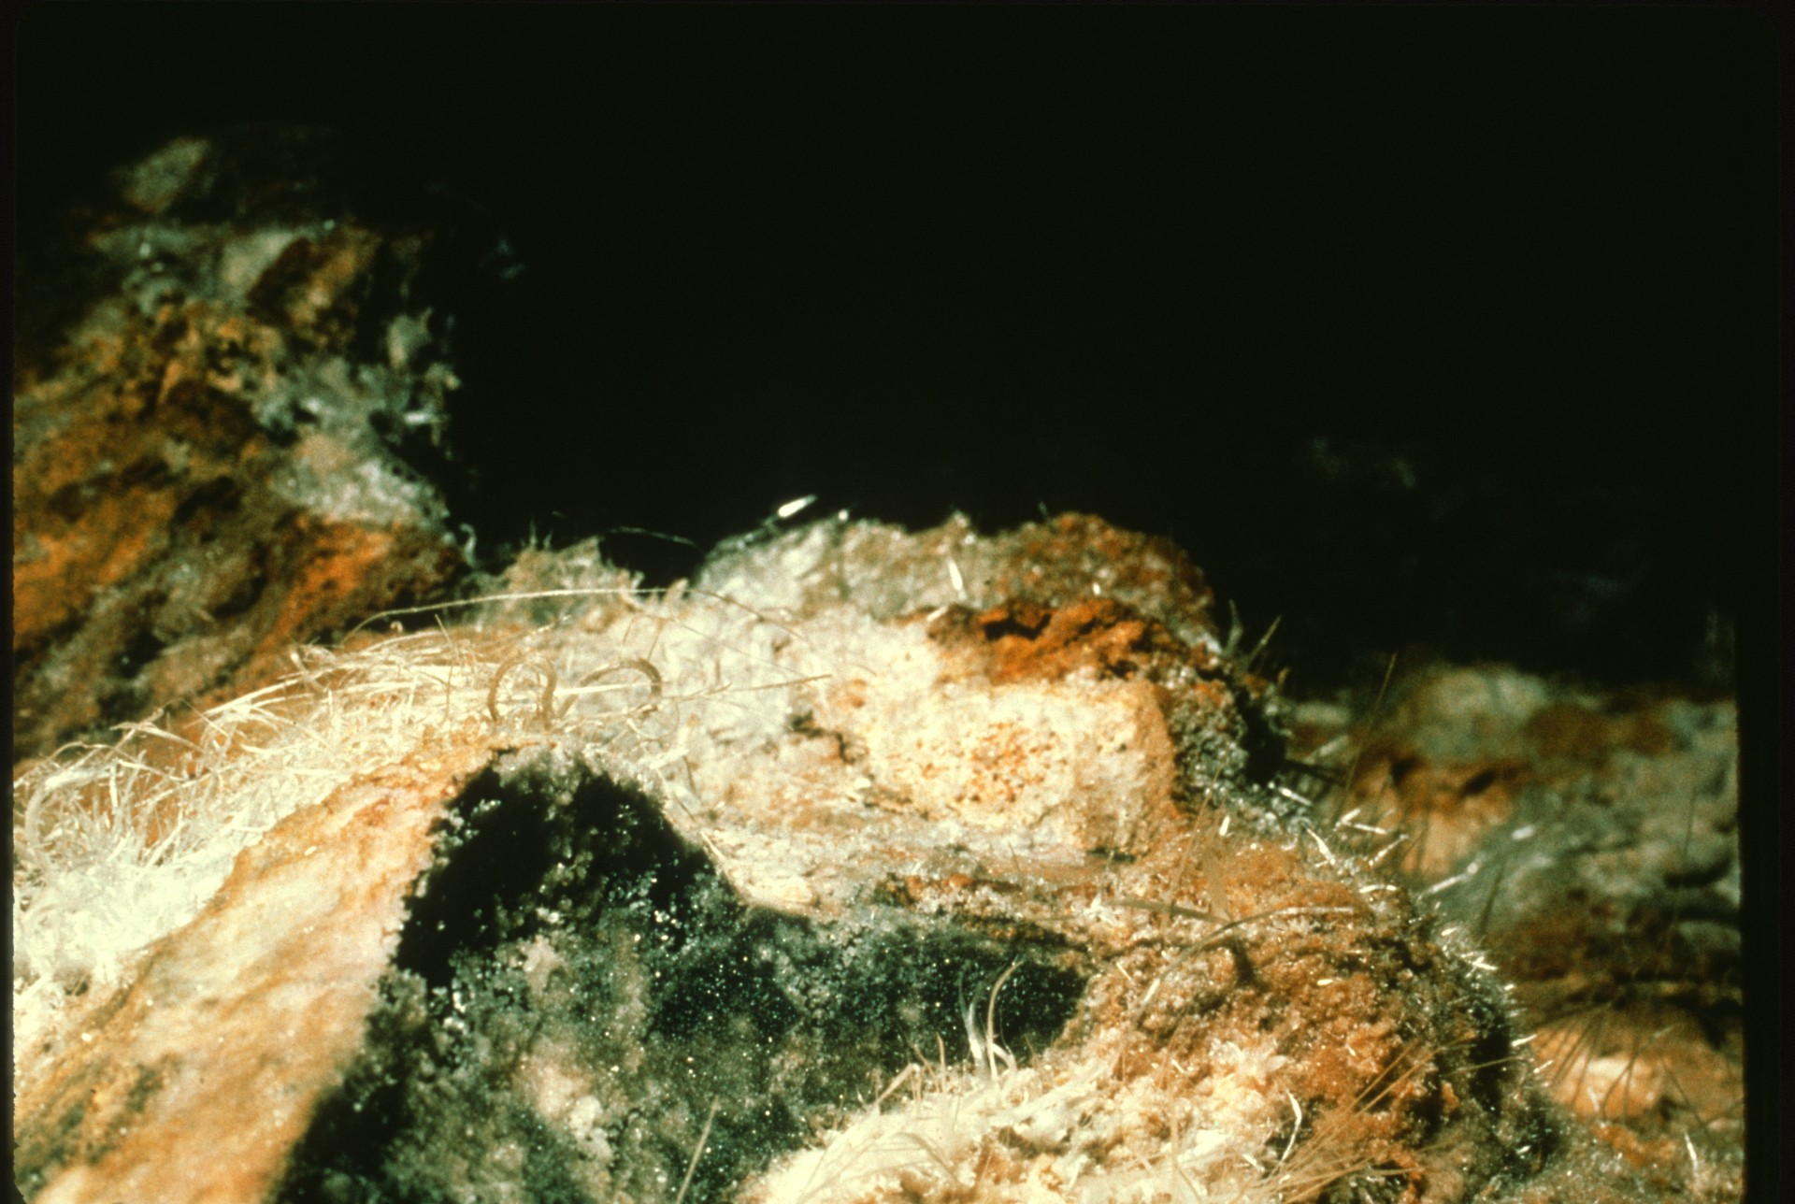
Notes:
The same view a few months later after documented vandalism.

Slide 27
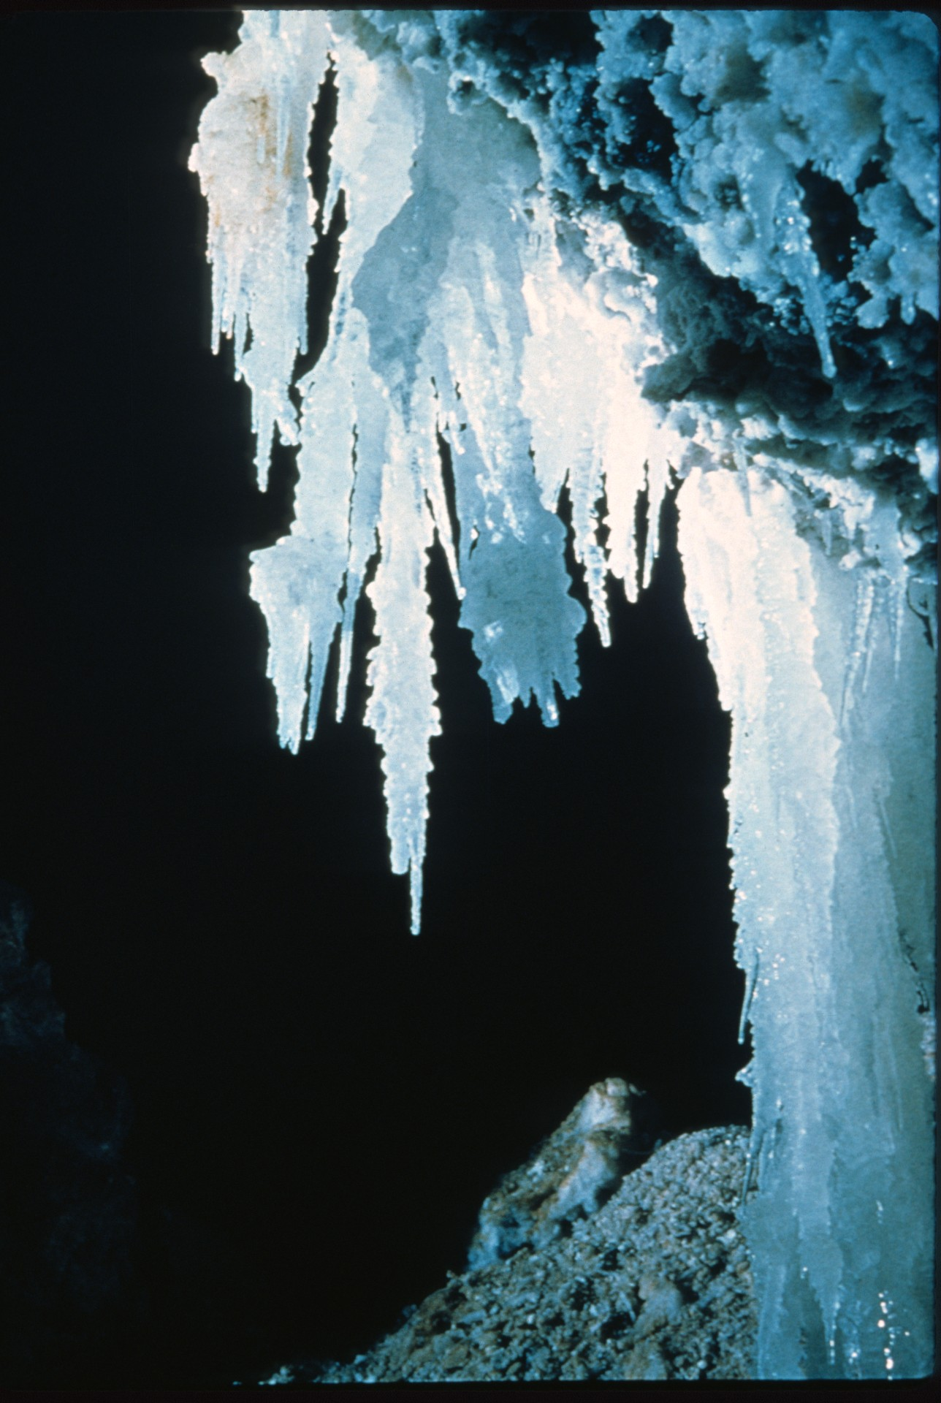
Notes:
Another photo of beautiful gypsum needles.

Slide 28
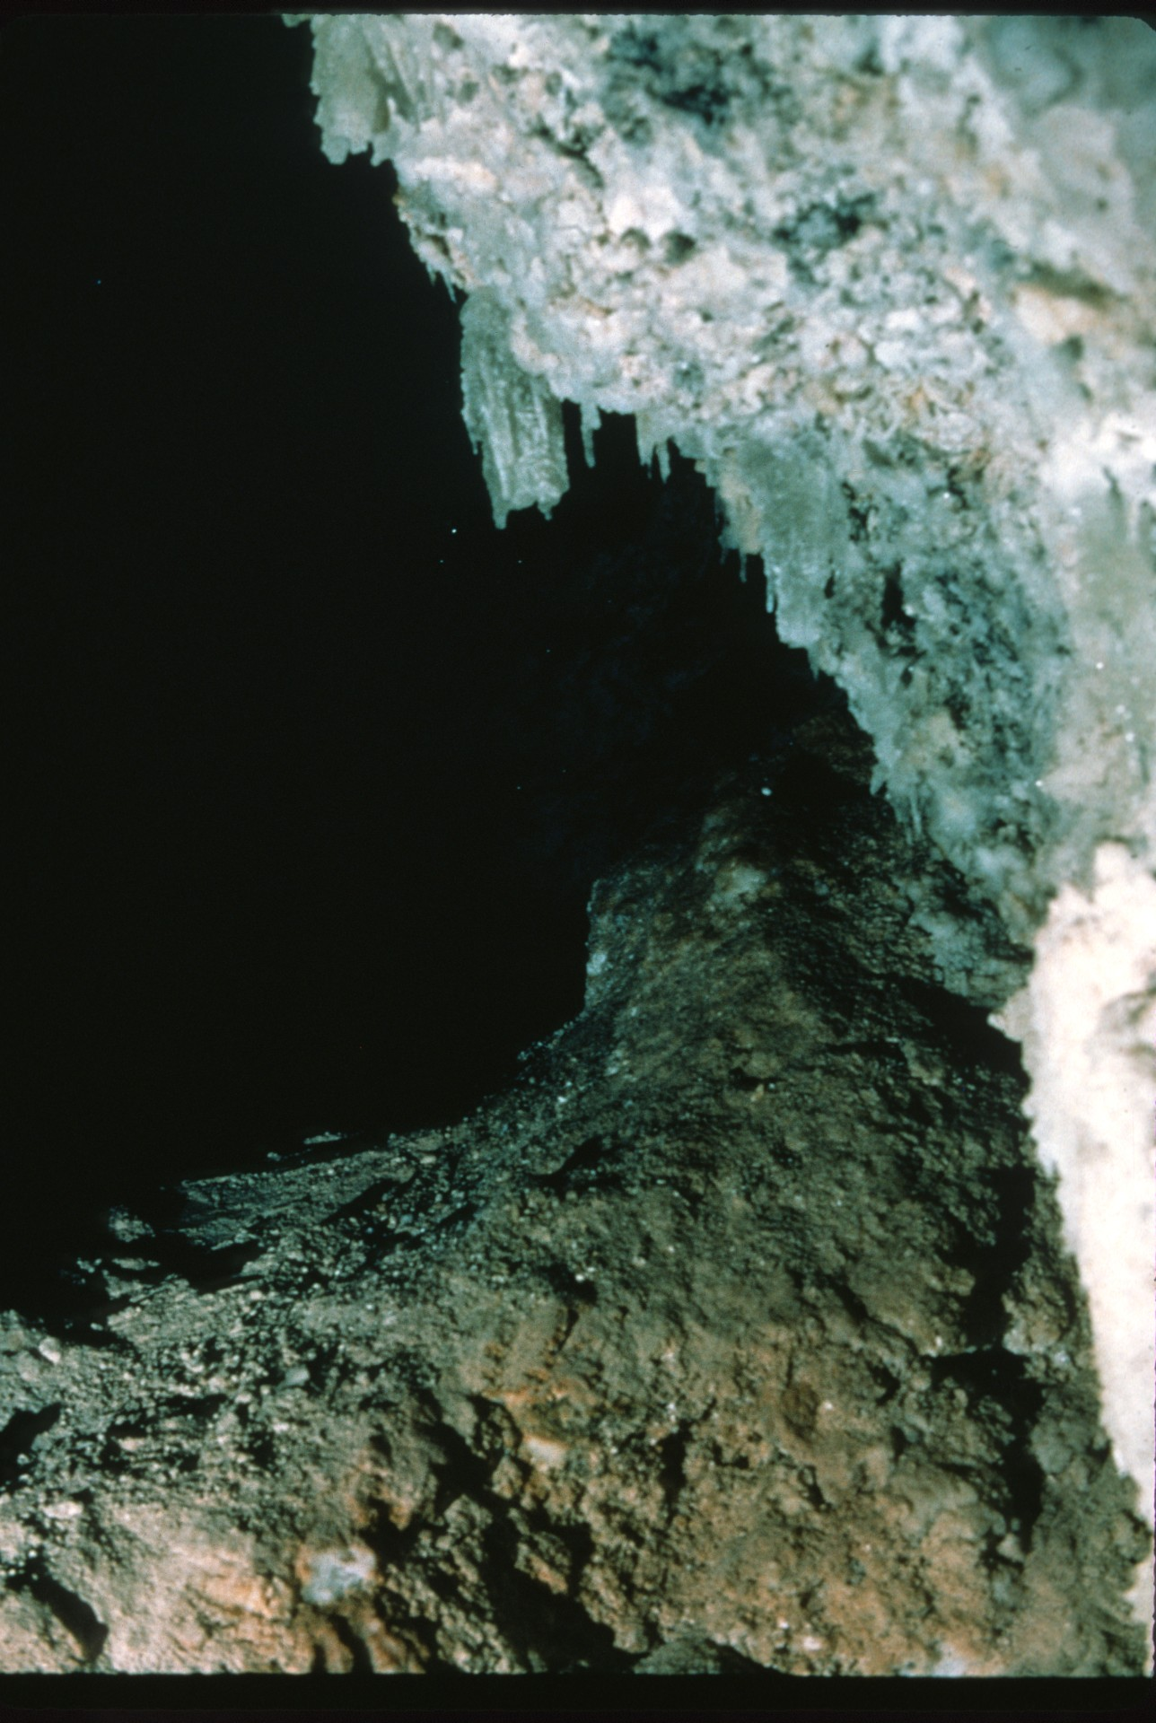
Notes:
Later on, after being disturbed. It should be noted that formations such as these can also be lost due to natural or environmental conditions, and not just to vandalism.

Slide 29
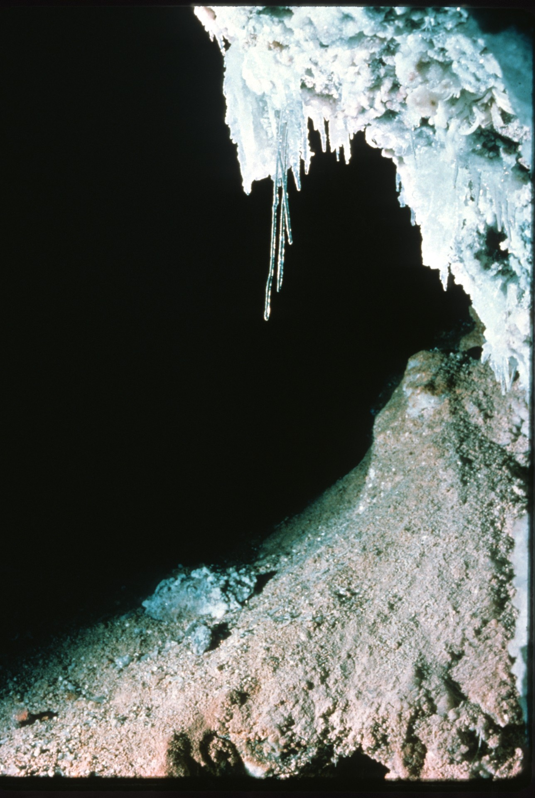
Notes:
But in either case, sometimes nature, if left alone, will allow some rejuvenation over a period of time as seen in this series of photos of delicate selenite formations.

Slide 30
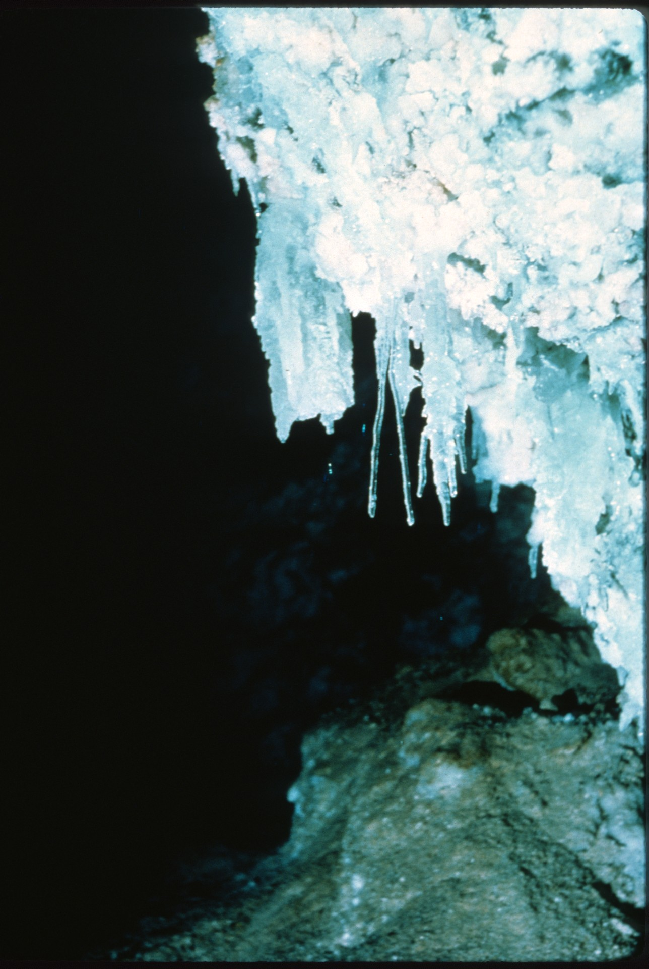
Notes:
After being disturbed.

Slide 31
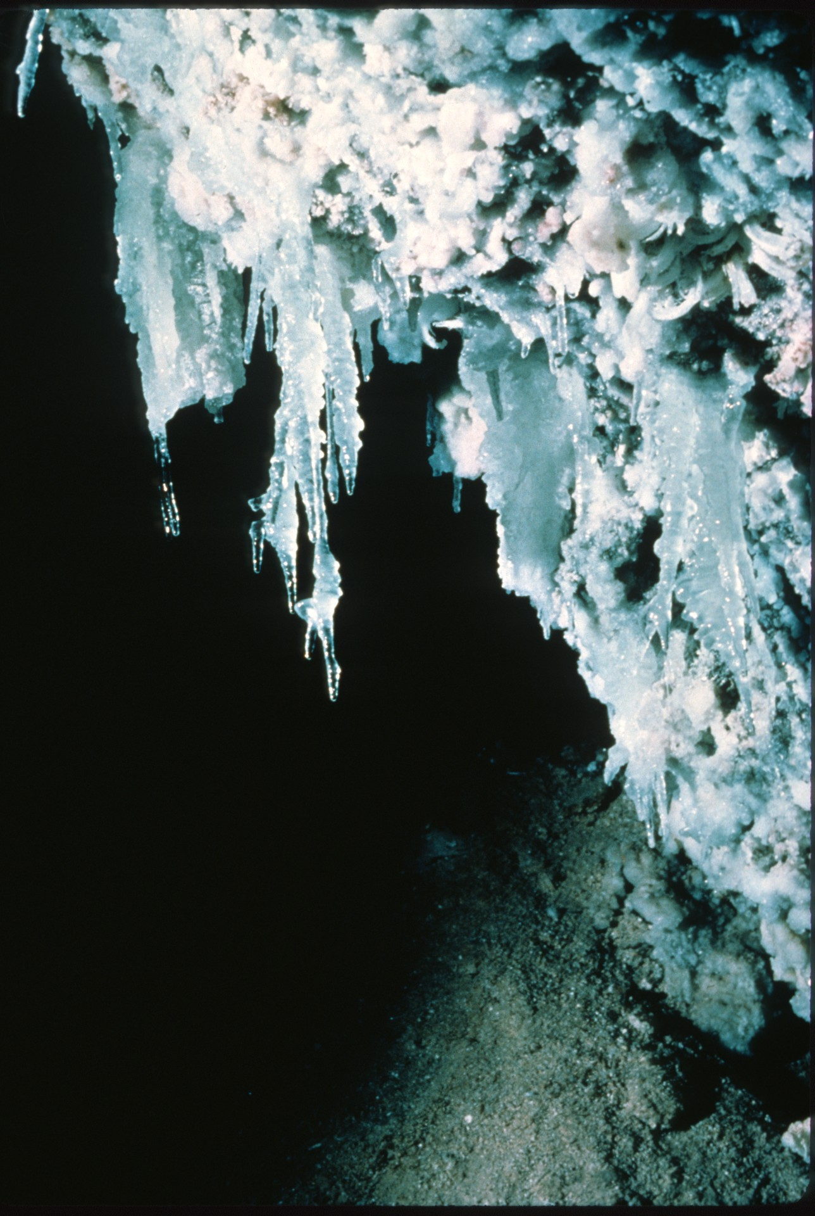
Notes:
Beginning of regrowth only a few months later.

Slide 32
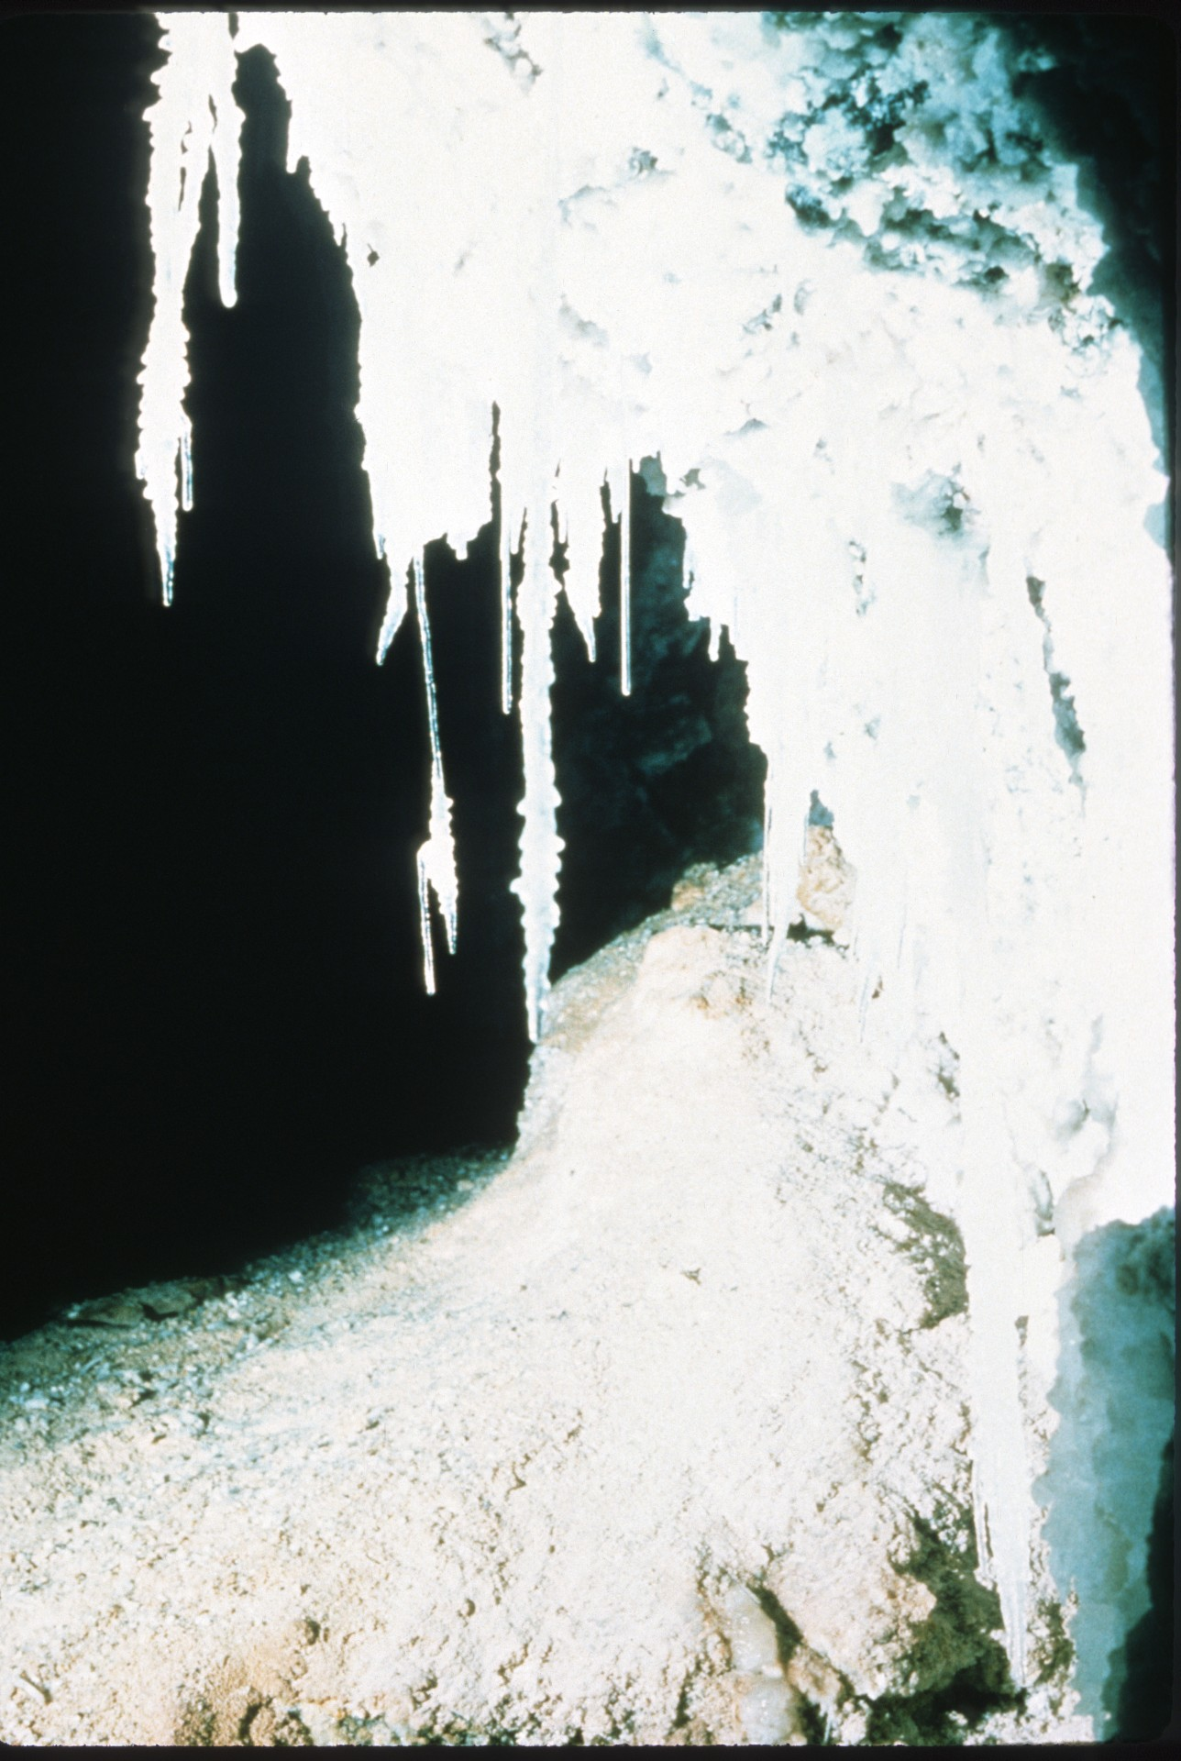
Notes:
Continuation of regrowth.

Slide 33
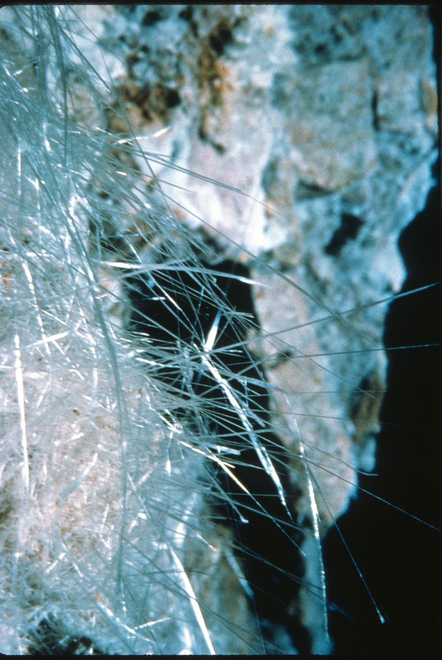

Slide 34
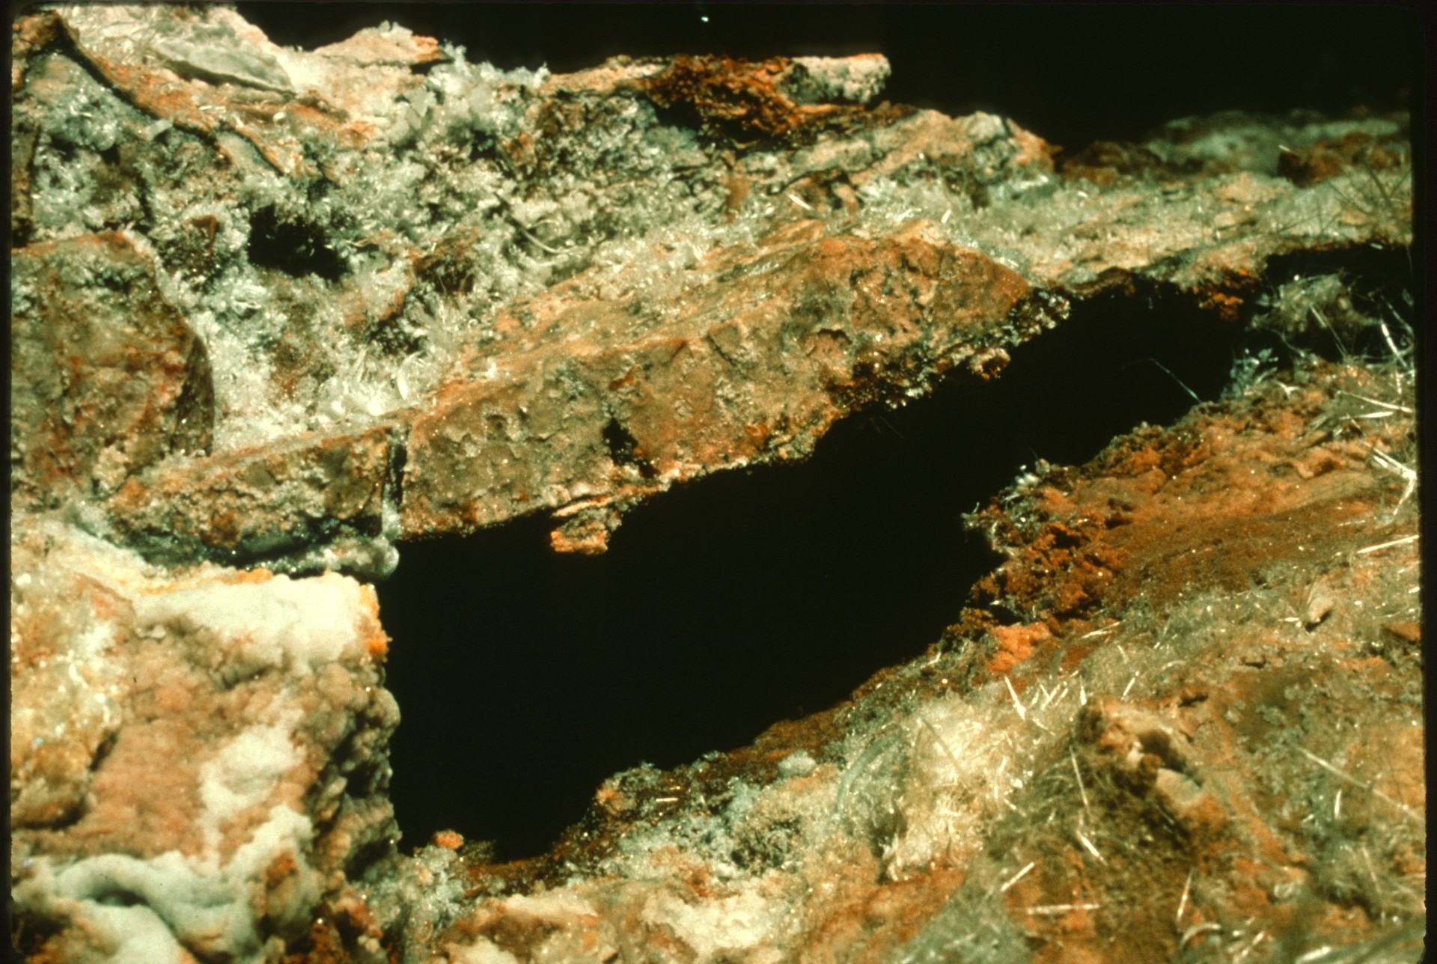

Slide 35
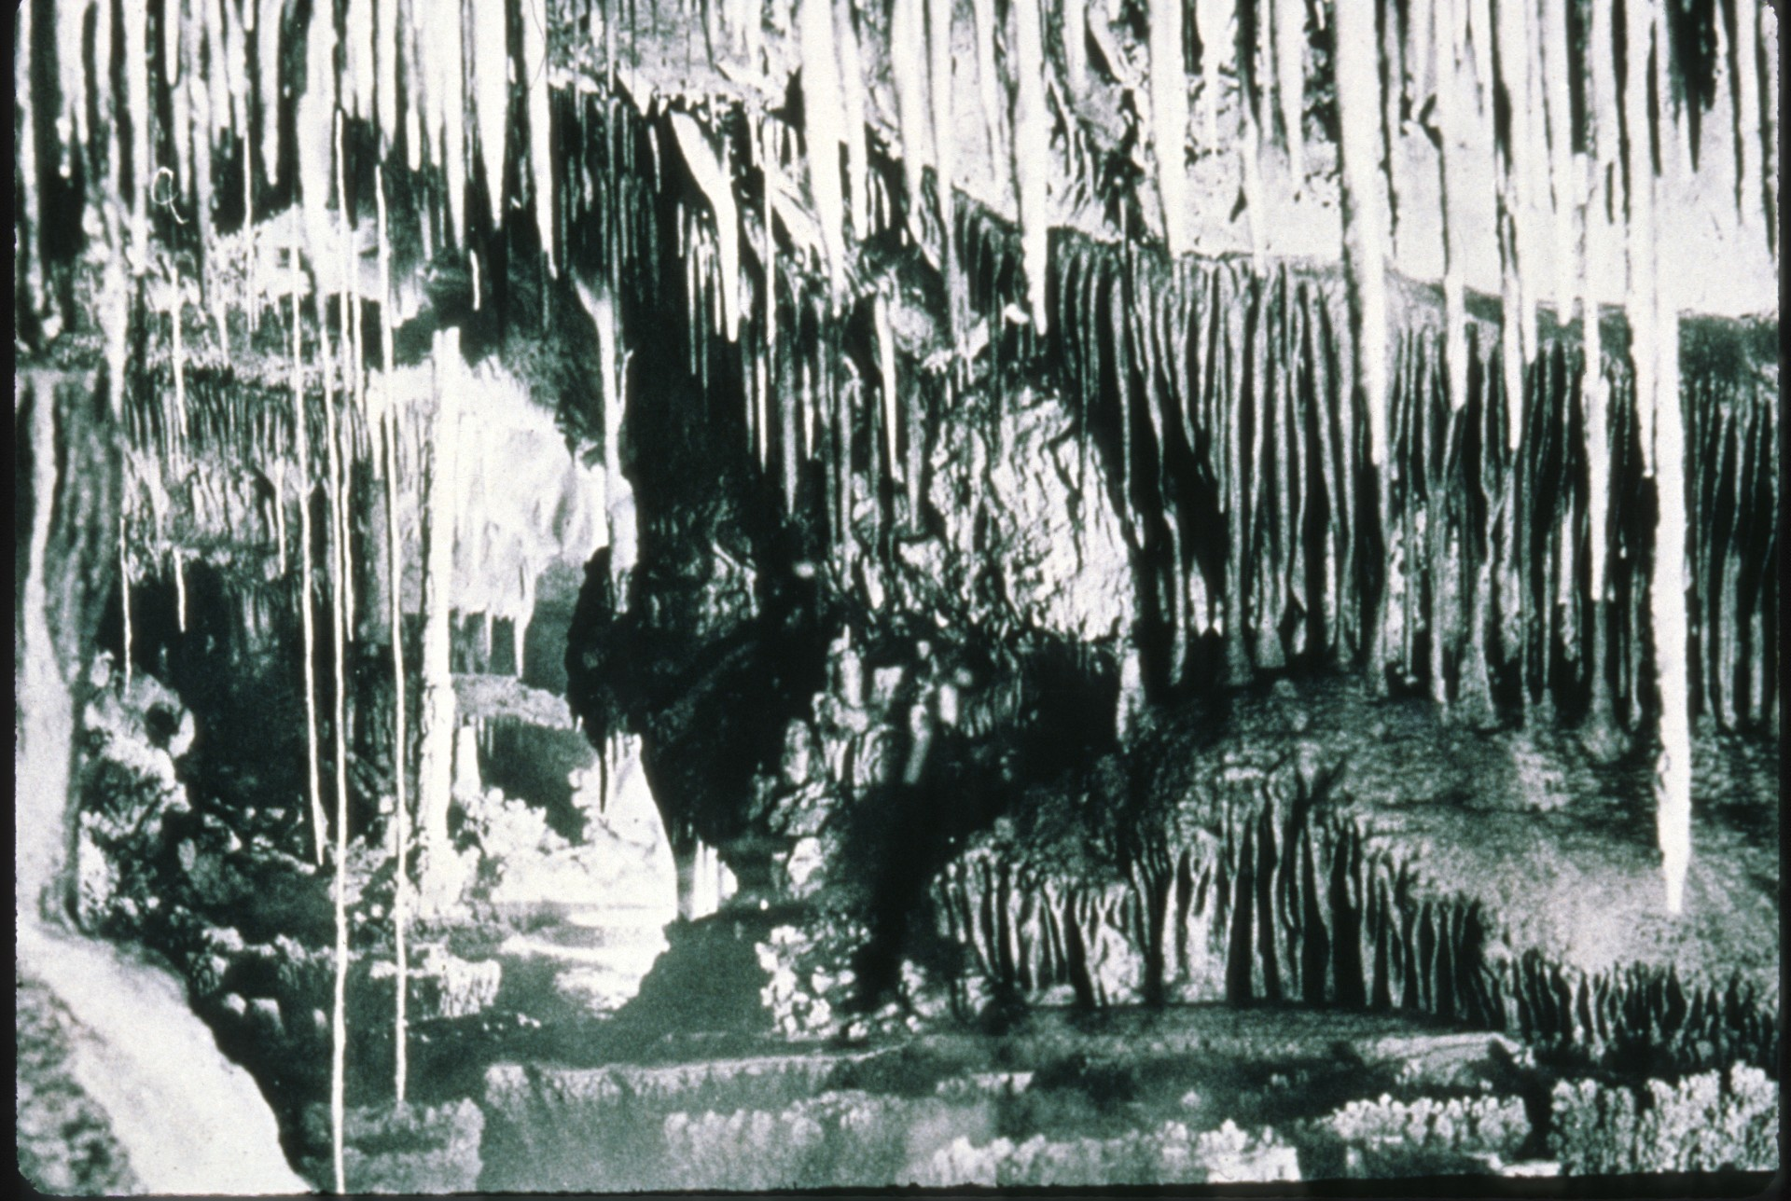
Notes:
This photo was taken in 1934 in Endless Cave, New Mexico.

Slide 36
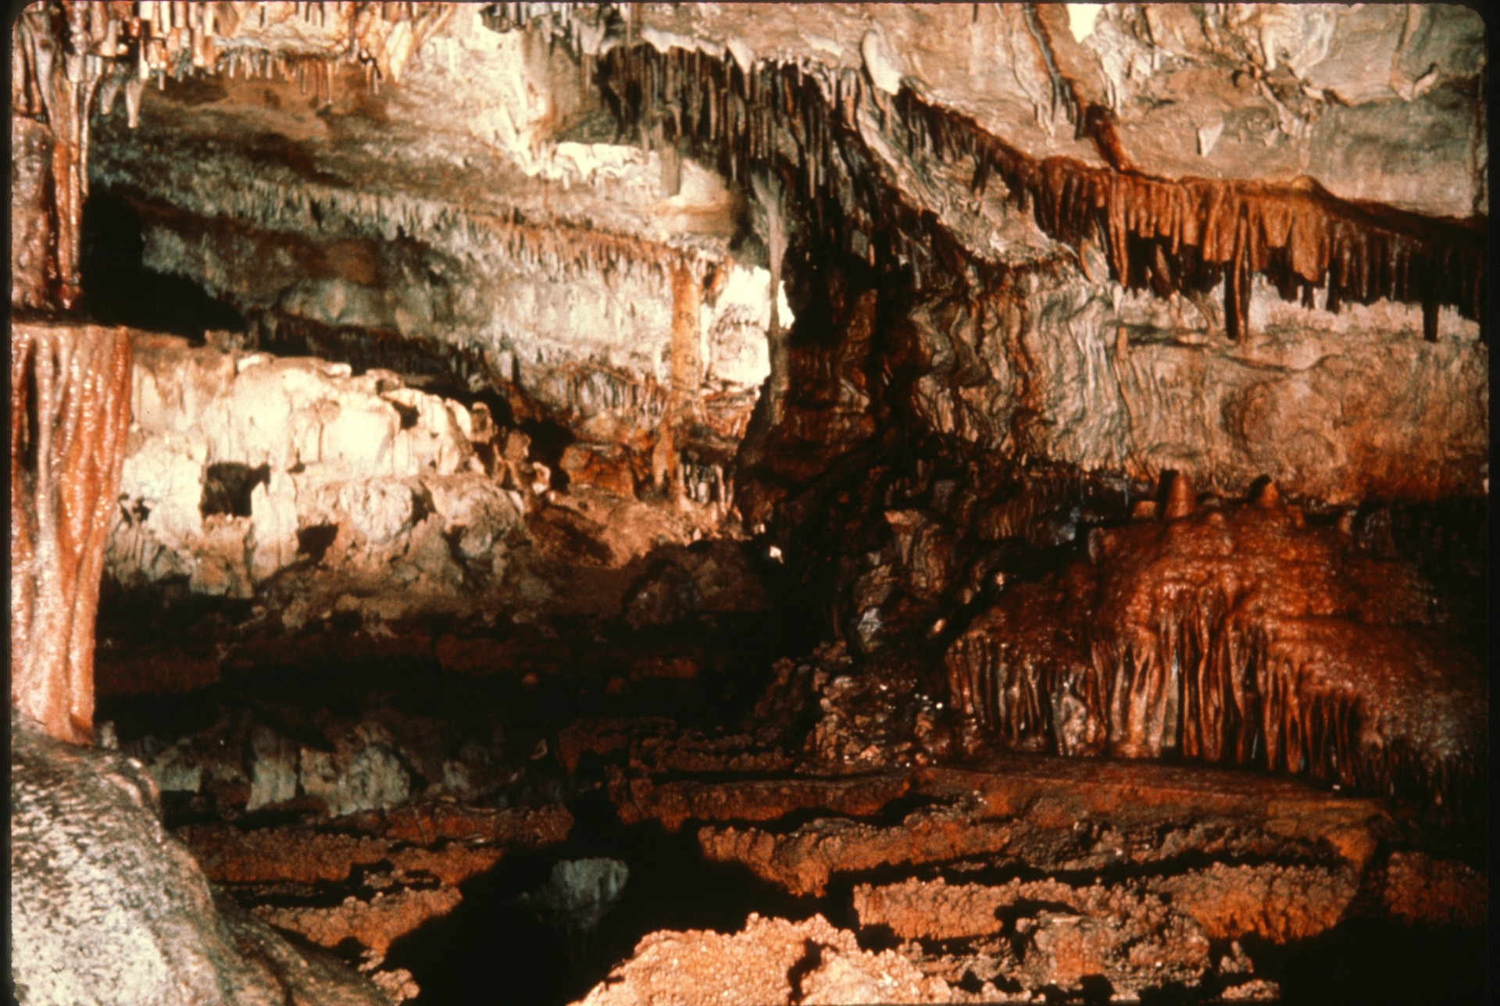
Notes:
In 1980, this is the same area of Endless Cave after years of souvenir taking and vandalism.

Slide 37
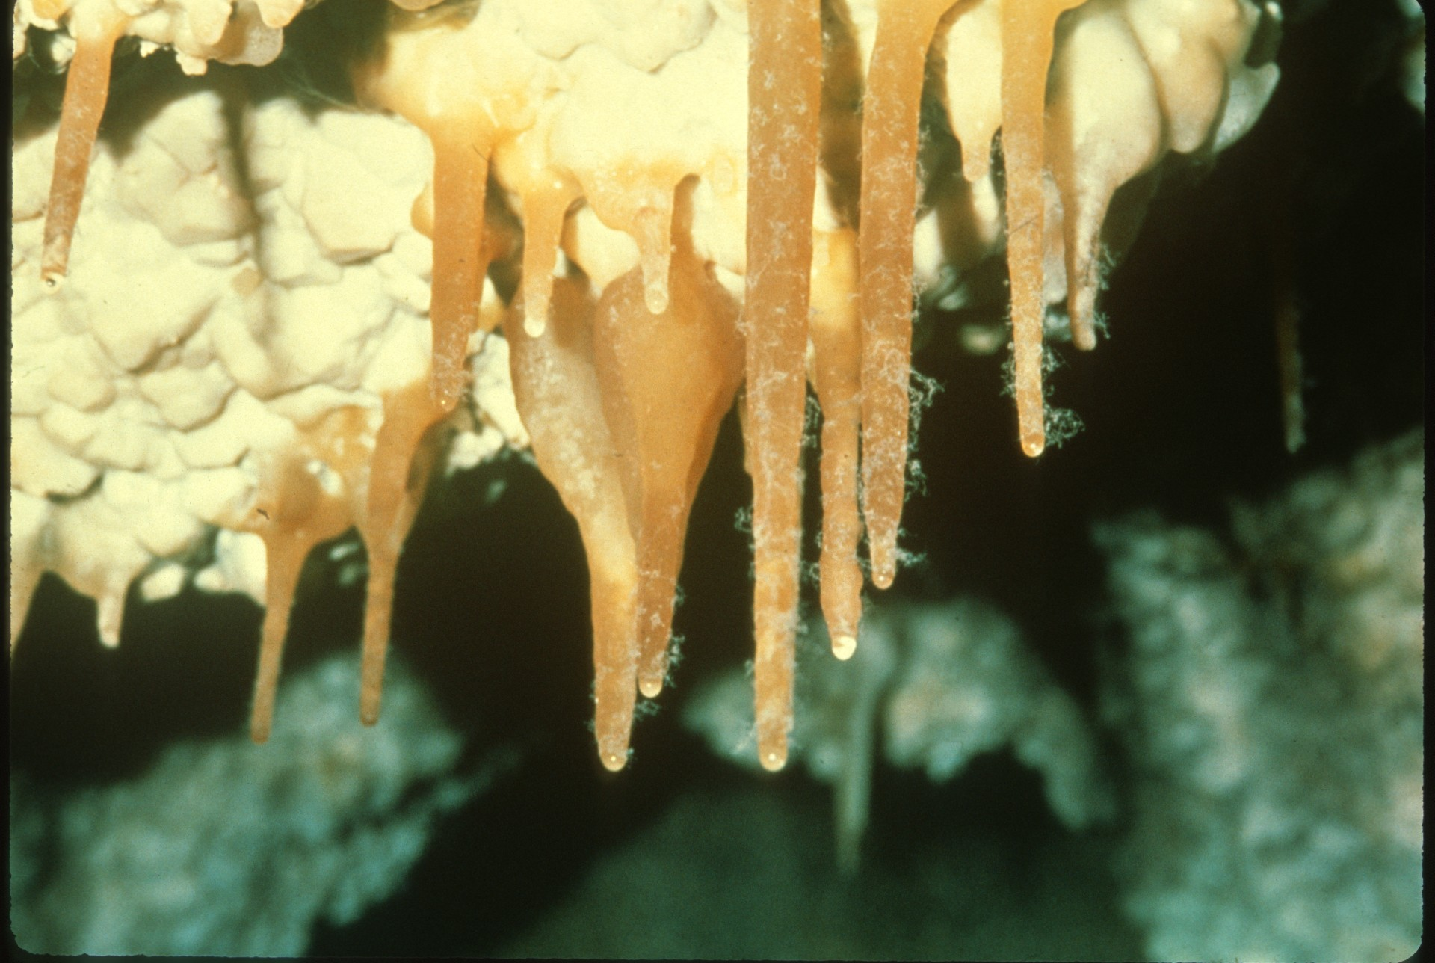
Notes:
Now we move on to a restoration problem many may not be aware of: lint. Here are dramatic photos taken in Jewel Cave, South Dakota, of lint caught on formations.

Slide 38
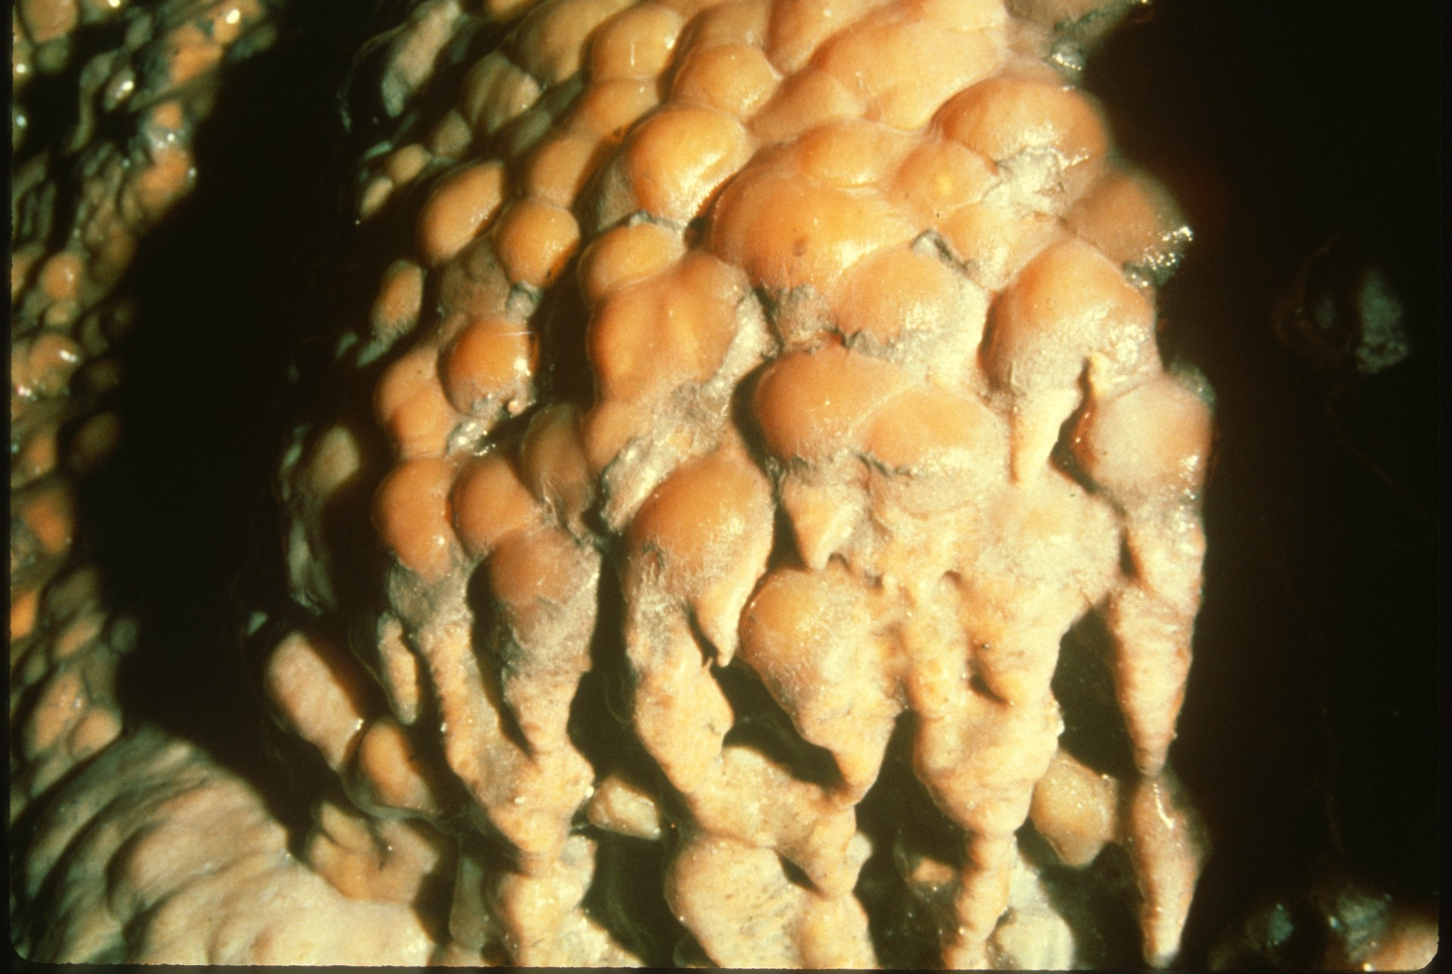

Slide 39
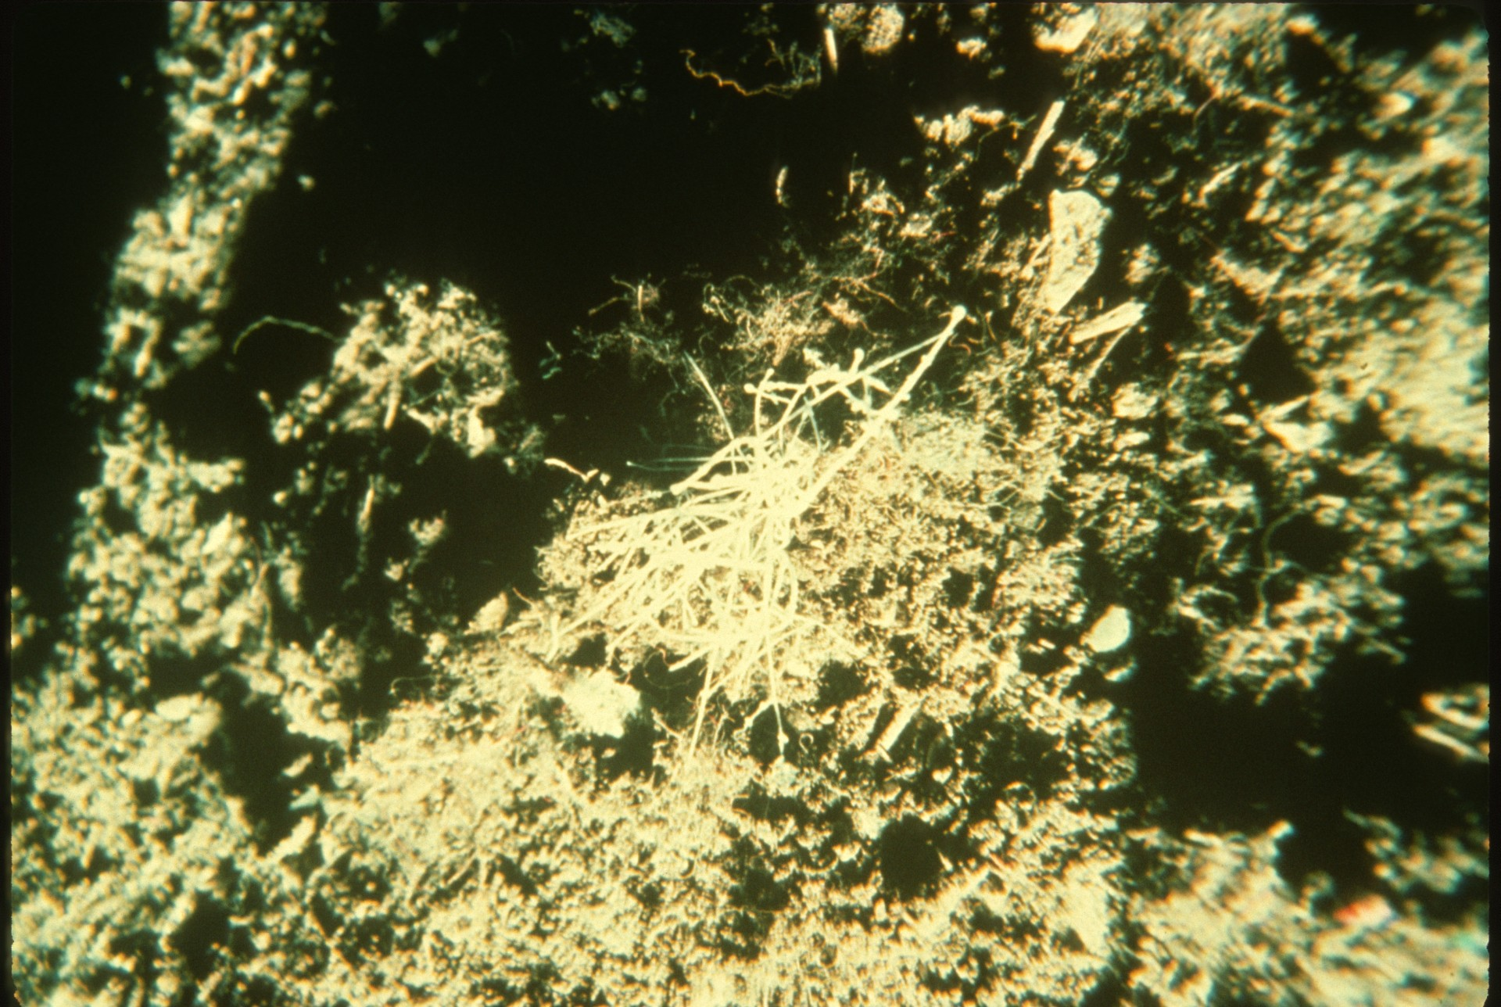
Notes:
Here we see a new formation which is growing on top of existing lint.

Slide 40
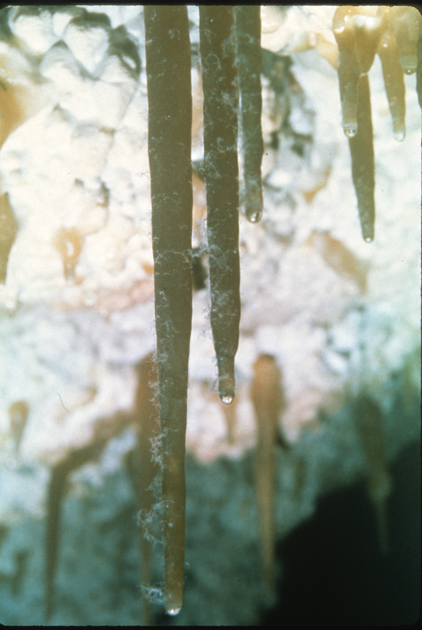
Notes:
Other formations at Jewel with lint attached. Perhaps a new cave formation? Linttites! Just kidding, folks!

Slide 41
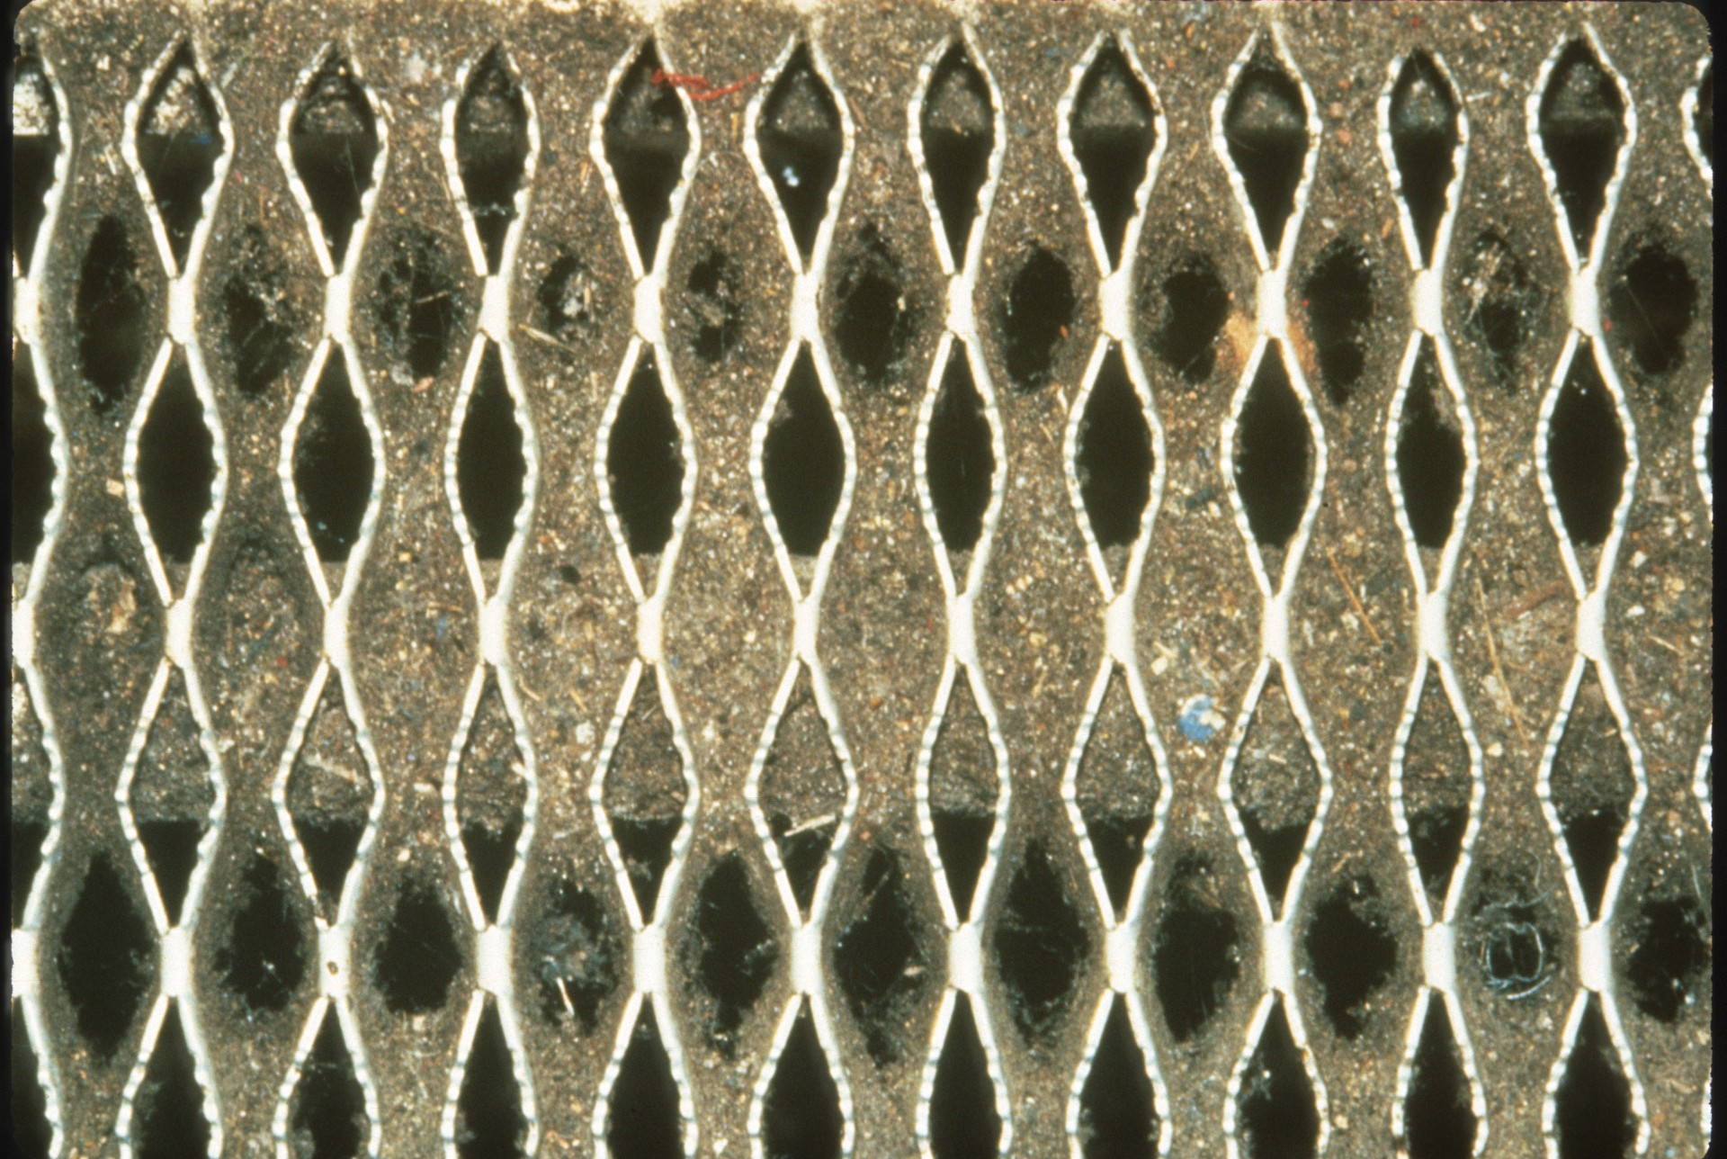
Notes:
Notice the debris and lint accumulating on the step.

Slide 42
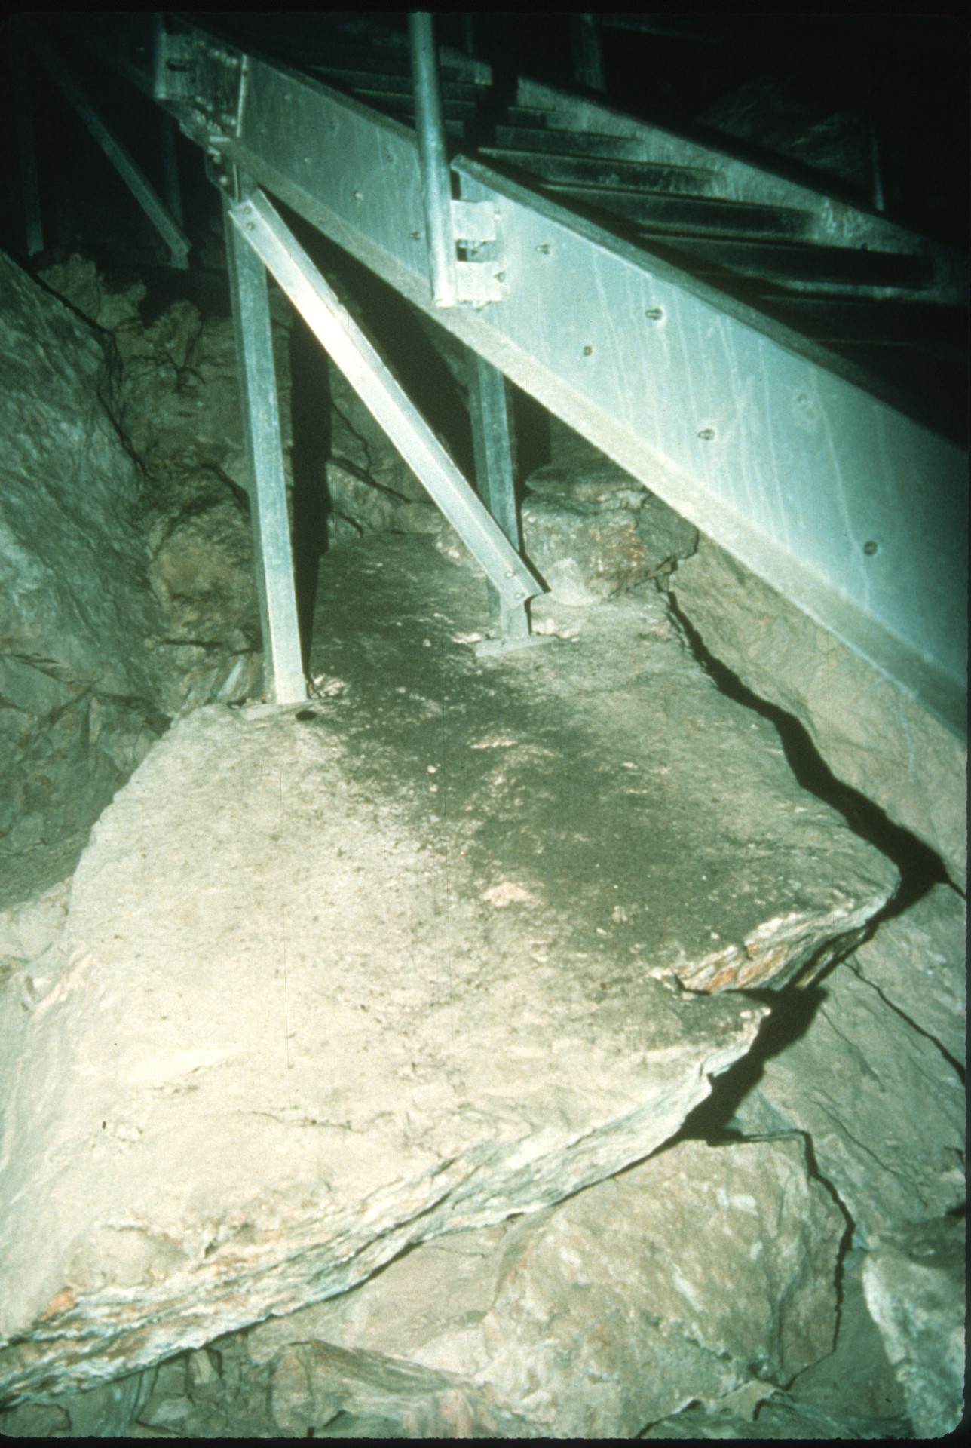
Notes:
Notice the debris and lint accumulating under the stairs on the cave floor. These photos were taken before a cleaning project was completed at Jewel Cave several years ago.

Slide 43
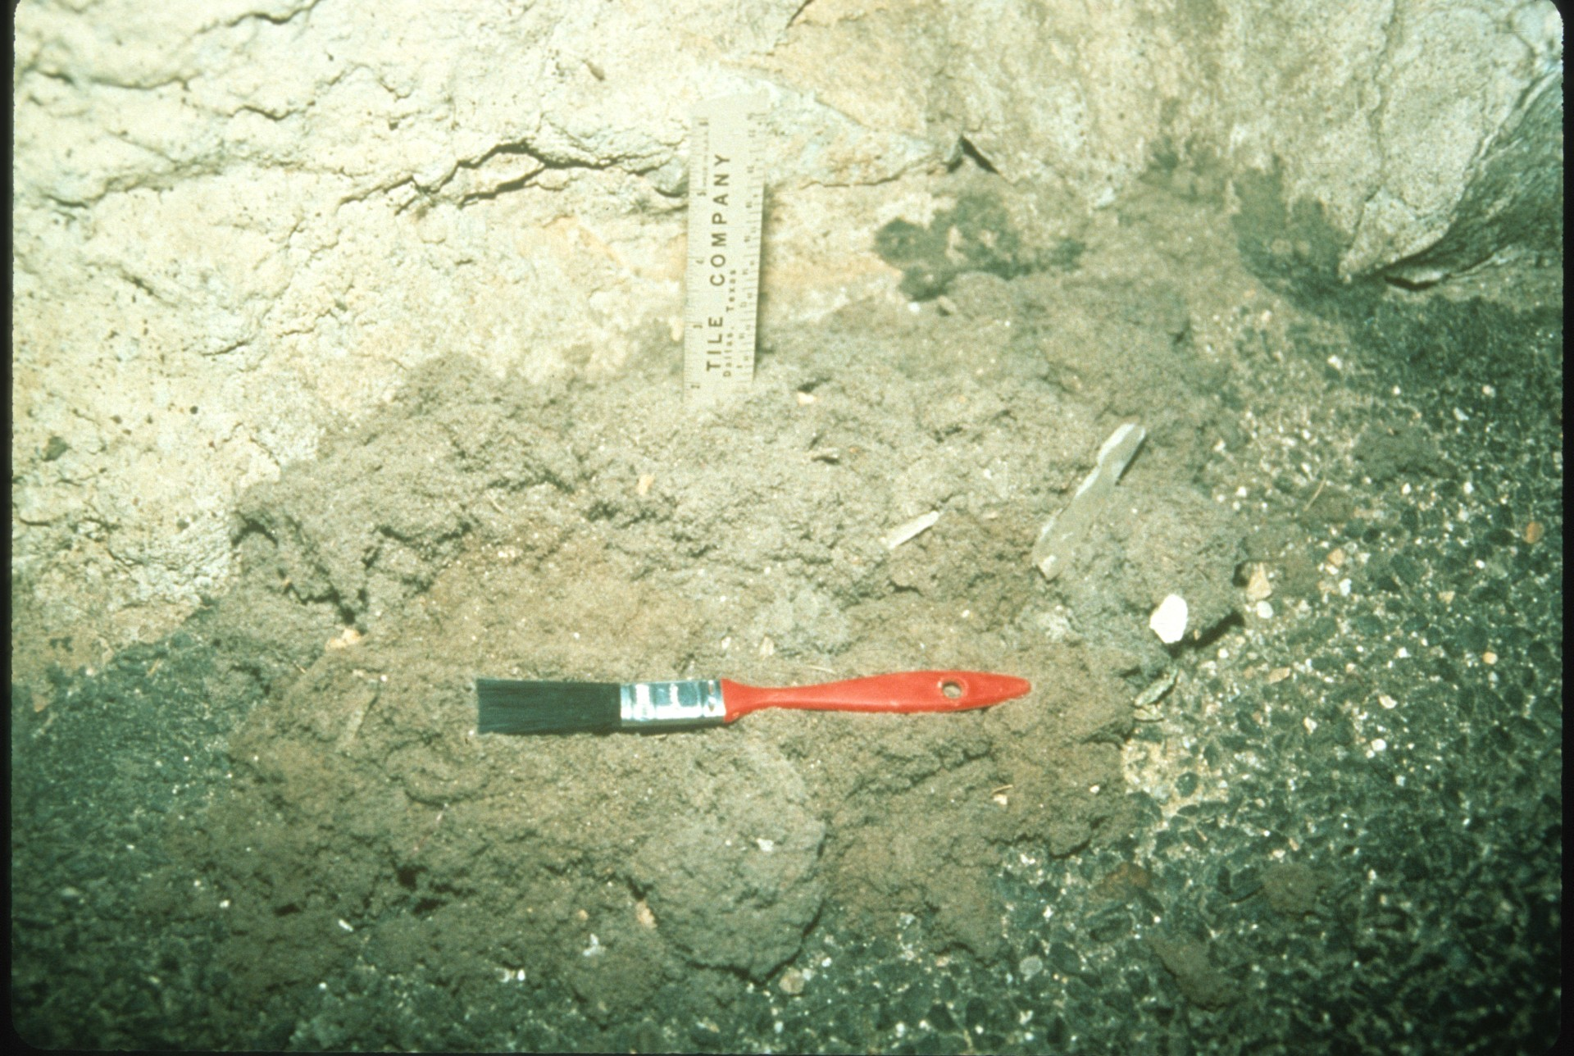
Notes:
In 1988, Denver Museum of Natural History members and staff completed the first restoration camp devoted entirely to the removal of lint from Carlsbad Cavern, New Mexico. As you can see from this series of photos, the lint was profuse in some areas.

Slide 44
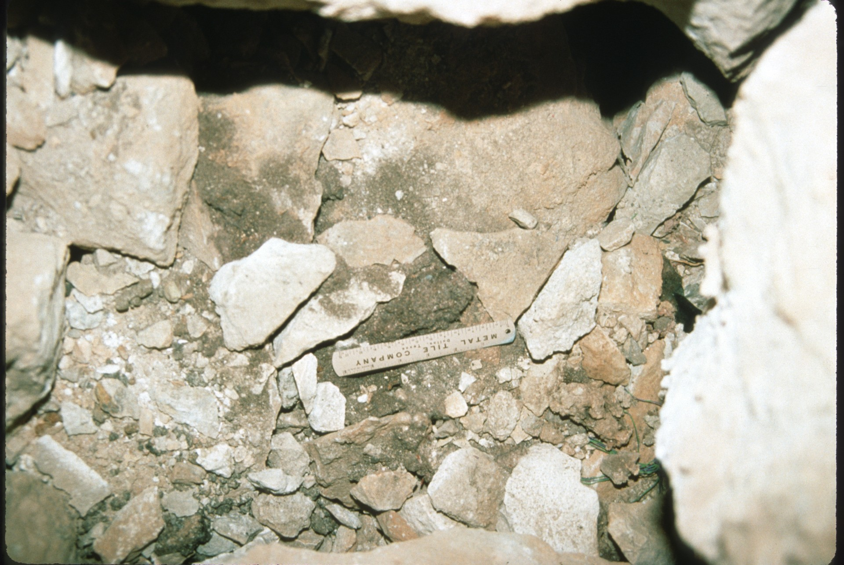

Slide 45
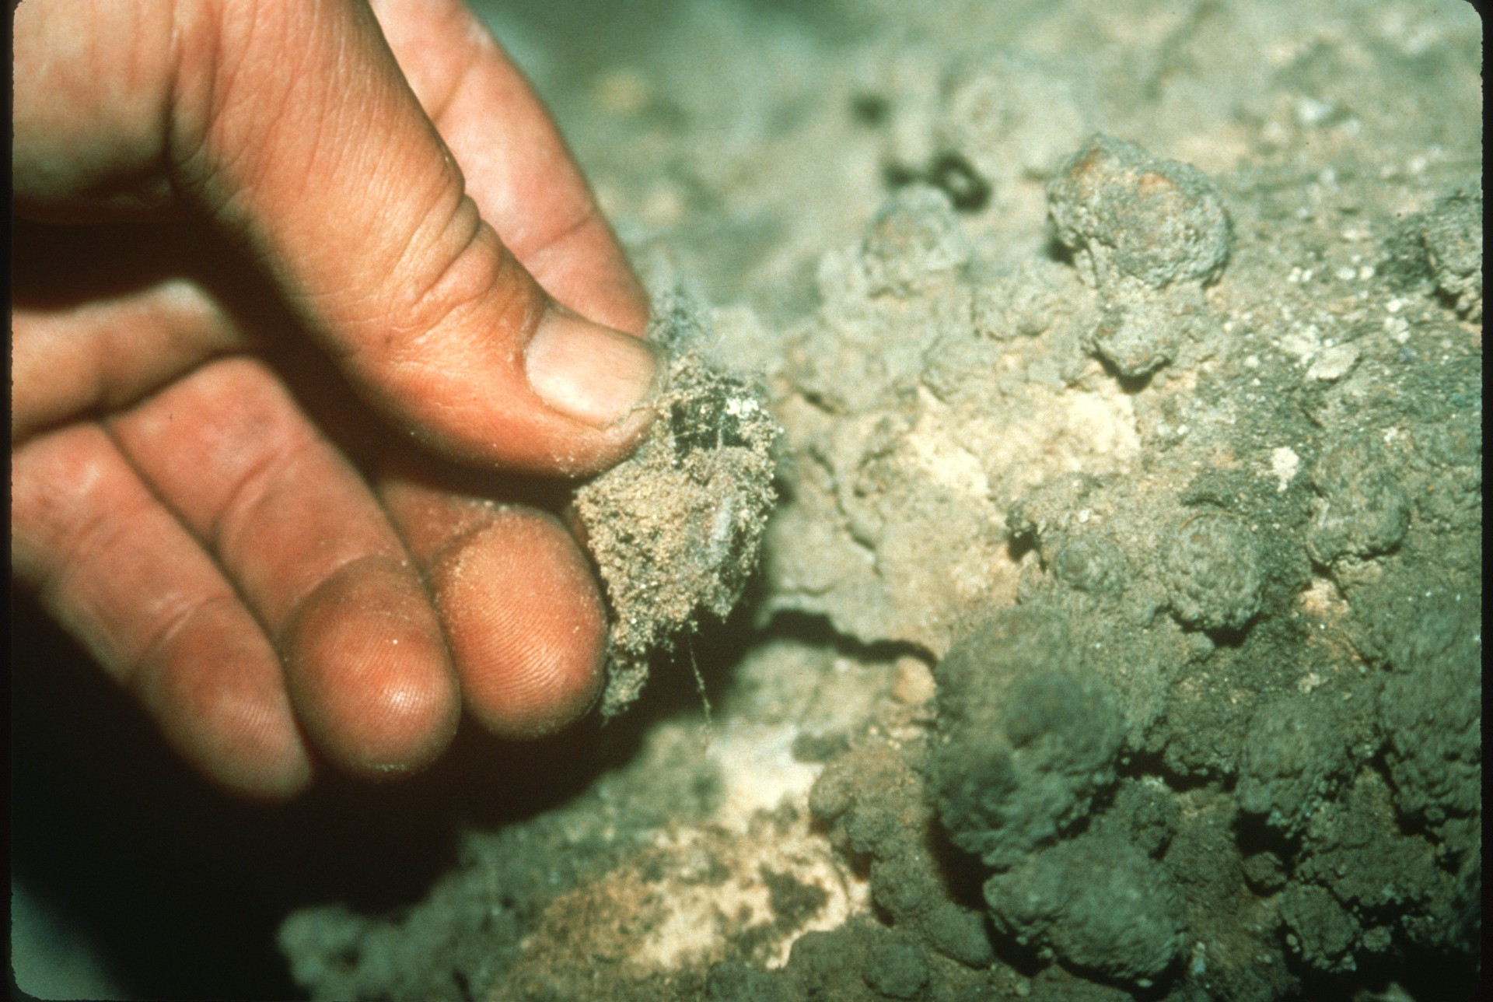

Slide 46
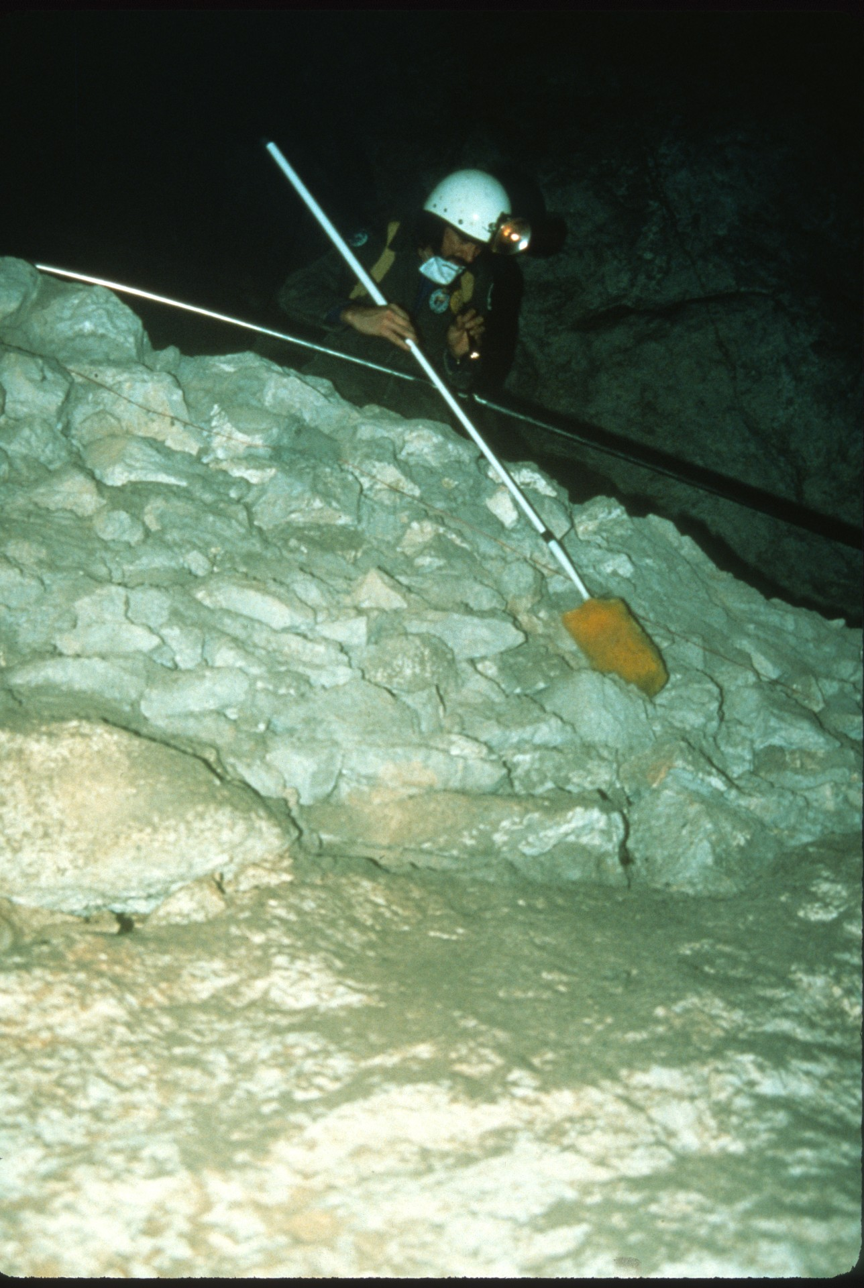

Slide 47
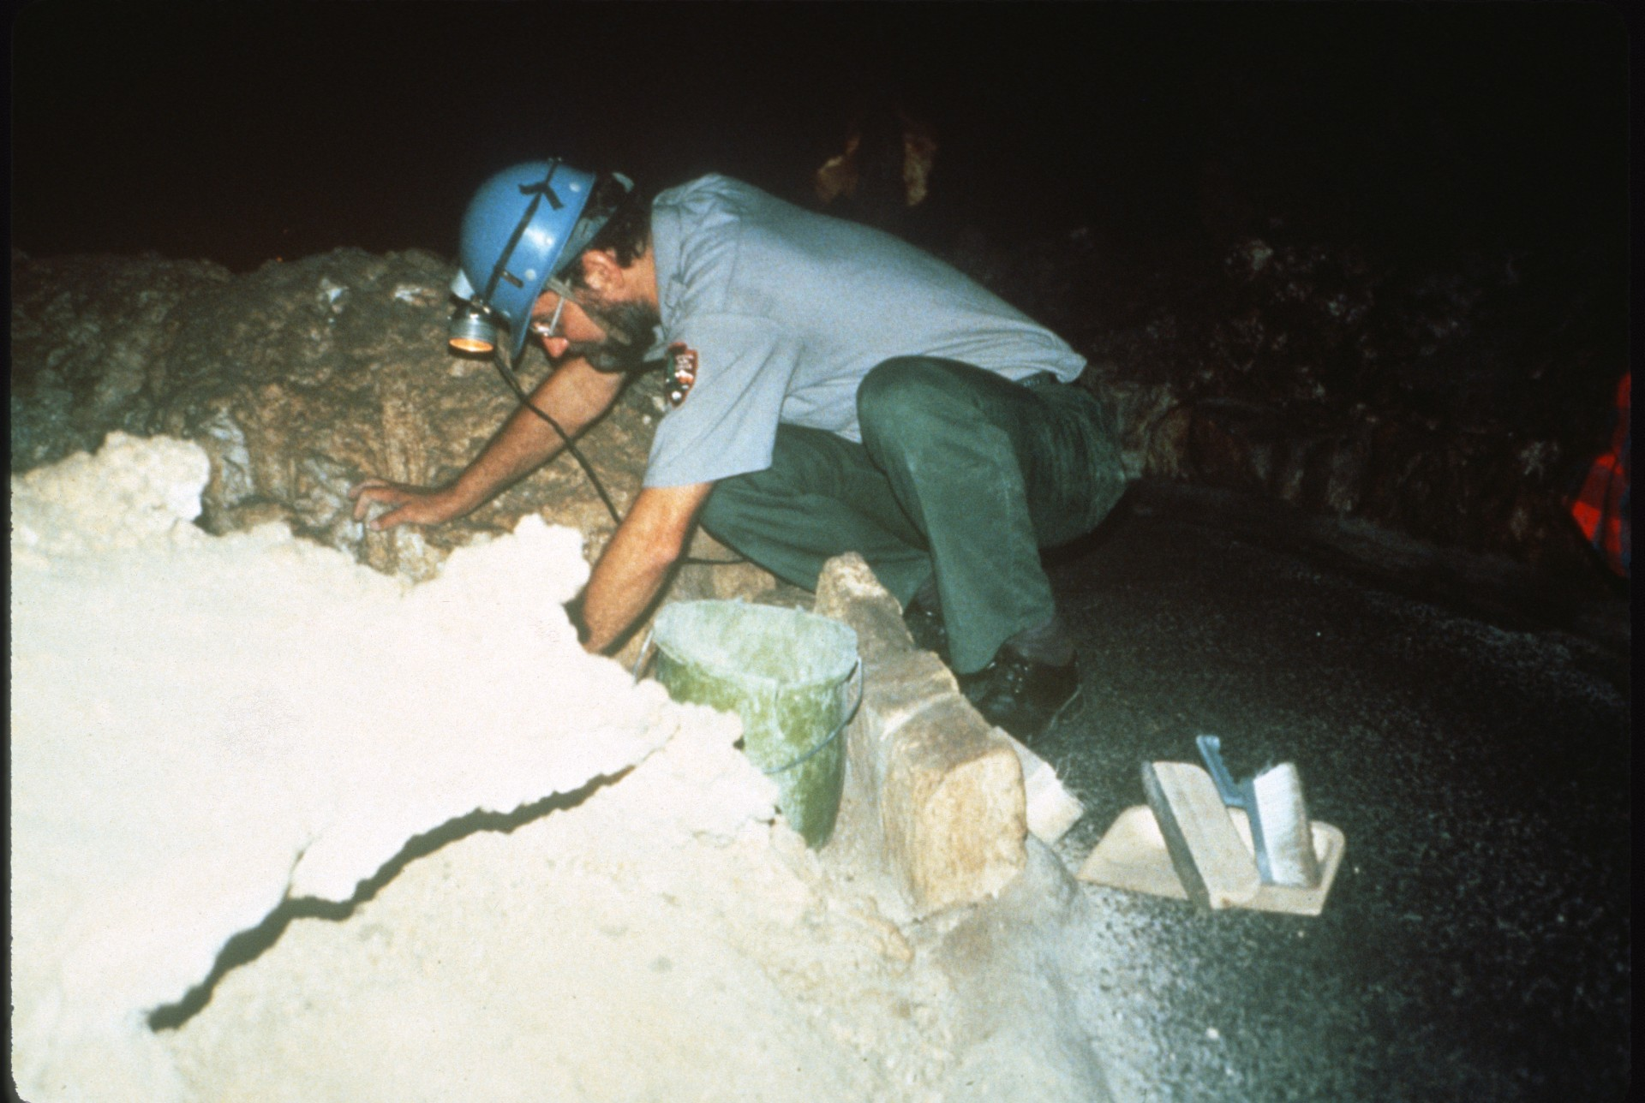
Notes:
John Roth, Cave Specialist at Carlsbad Cavern until November of 1988, now at Oregon Caves, Oregon, was responsible for the development of this project relating to lint in Carlsbad and also for studies on this impact lint can have on a cave and its environment.

Slide 48
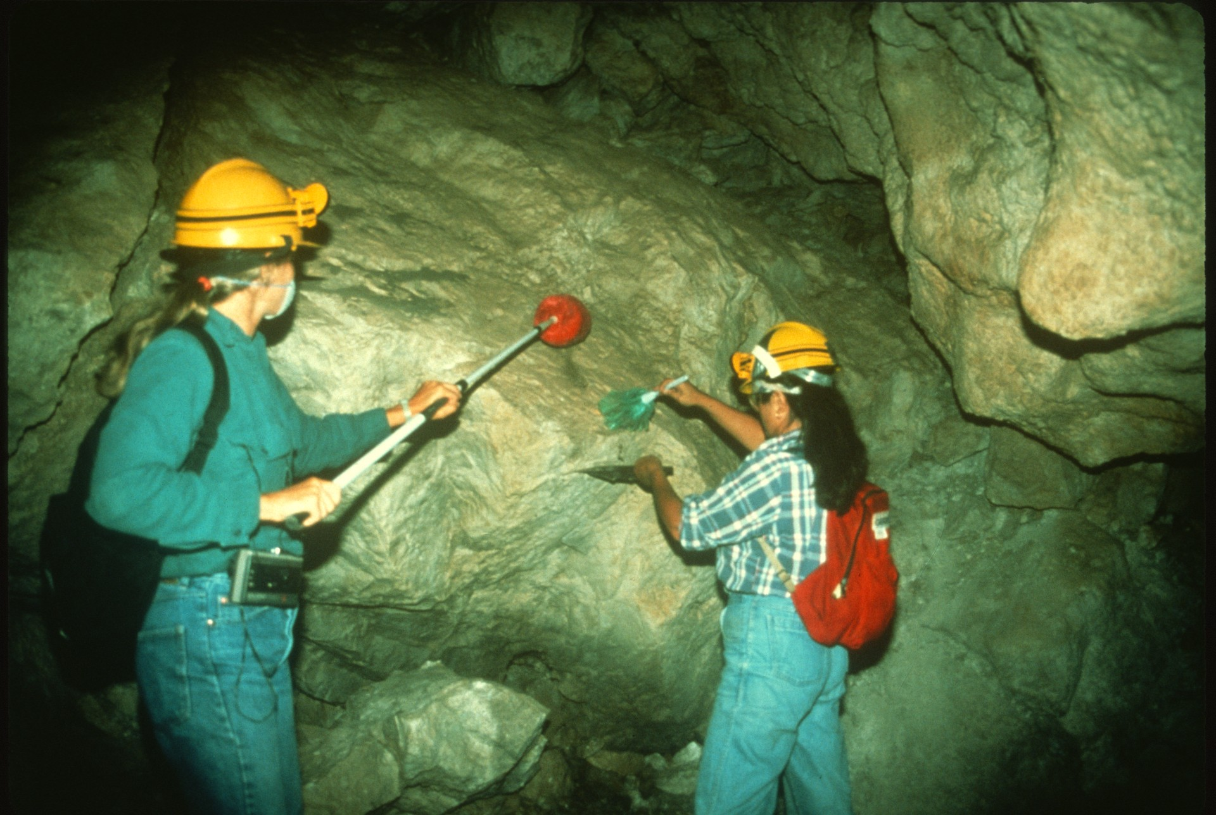
Notes:
In just four days with 21 Denver Museum members working a total of 400 hours, most of the cave was cleared of visible lint and debris along the trails from the entrance of cave through the “Big Room.” Quite an impressive feat! (Note: No mechanical tools were used.)

Slide 49
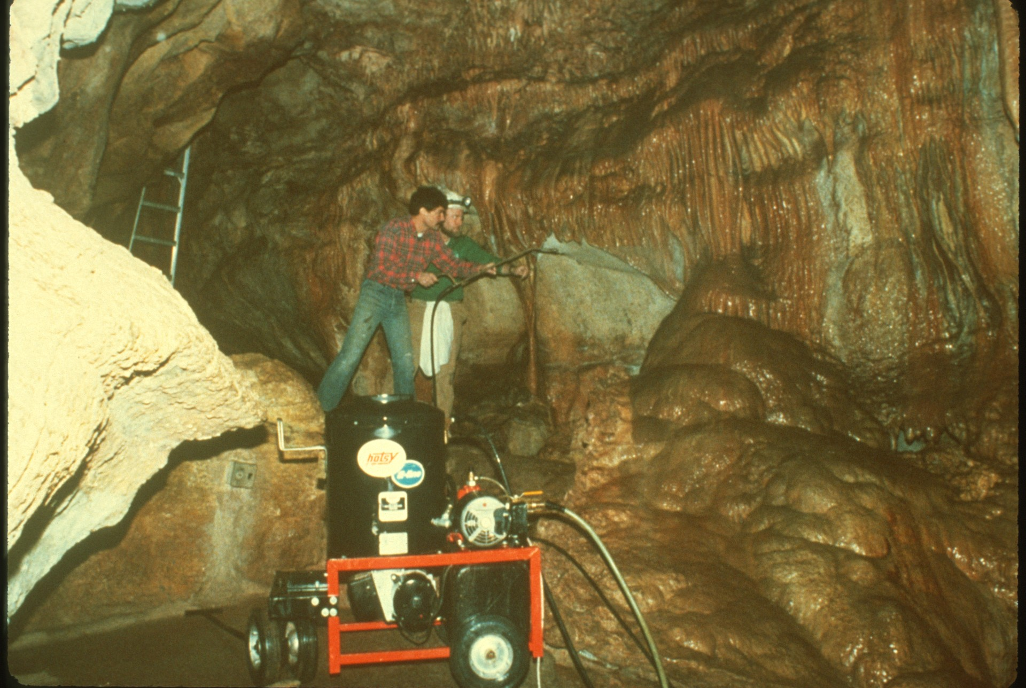
https://www.hotsy.com/en/
Notes:
At Cave of the Winds in Colorado, some cave cleaning is completed using a mechanical tool called a “Hotsy.” This machine is like a portable car wash. Using plain water and varying degrees of temperature and pressure, managers at Cave of the Winds are able to clean most areas along the commercial trails.

Slide 50
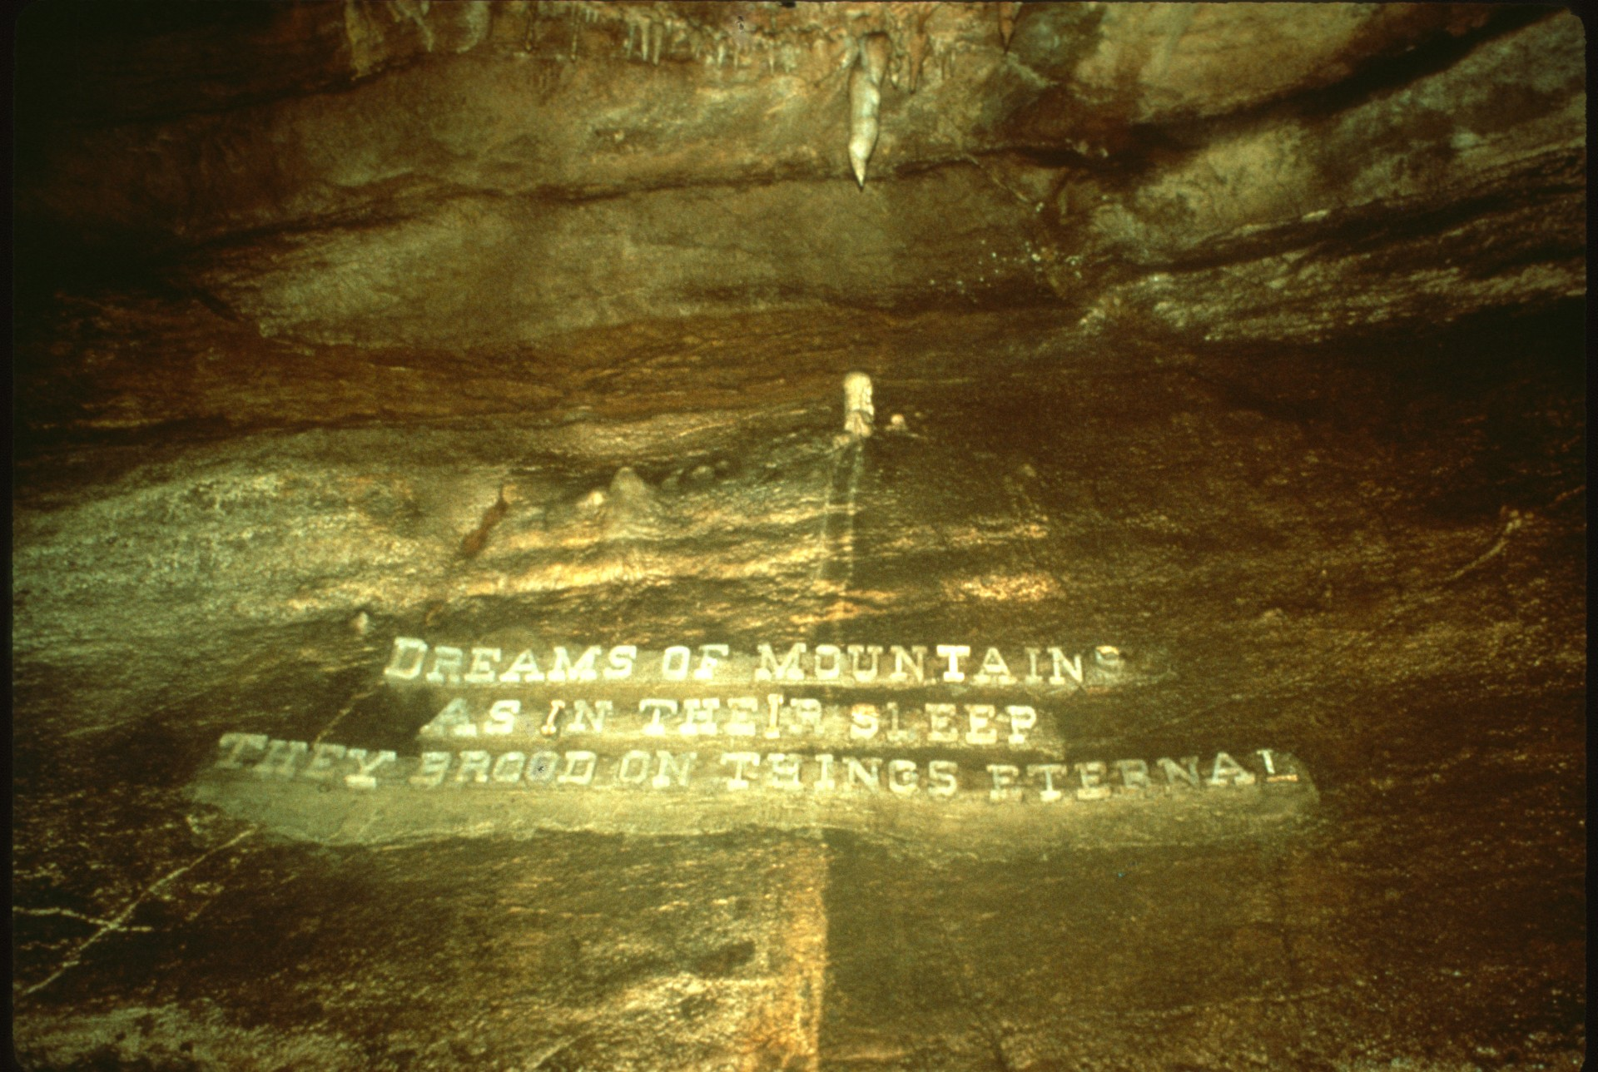
Notes:
Here is a nice before and after view utilizing the “Hotsy” machine in Cave of the Winds.

Slide 51
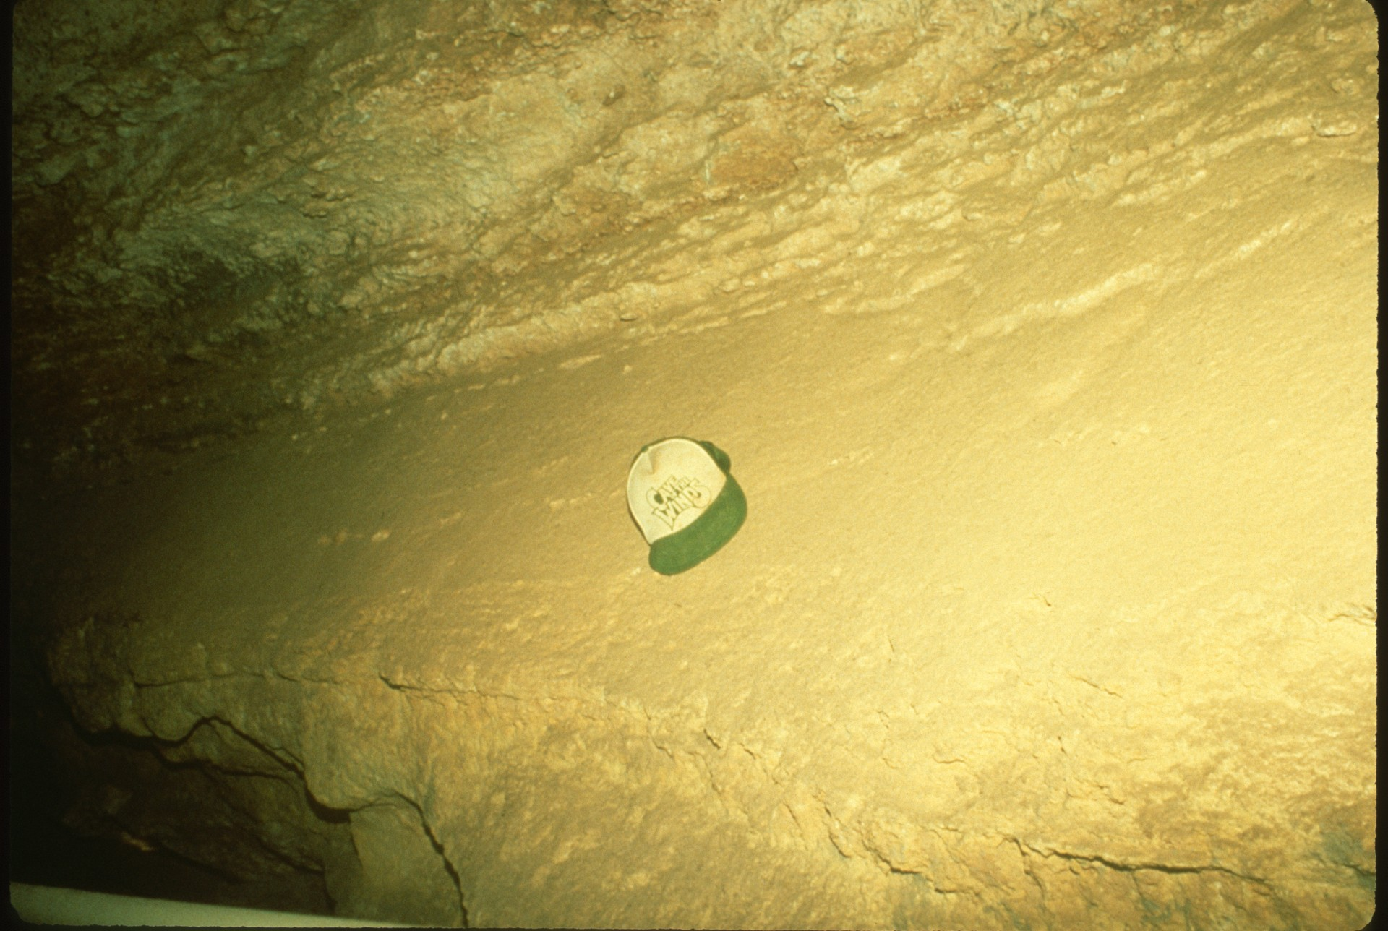
Notes:
Before

Slide 52
Notes:
After

Slide 53
Notes:
For years Carlsbad Cavern National Park has been in the forefront of cave restoration projects. Here are a few shots taken during the 1987 restoration showing reclamation of cave floors after the removal of an old trail built in the 1930s.

Slide 55
Notes:
Restoration work can take place during hours of visitation, giving visitors a chance to see how important the work is. It also gives cave management a chance to explain about the importance of cave maintenance and allows for a conservation message to be given.

Slide 57
Notes:
What a fine view of an area beautifully restored!

Slide 58
Notes:
For a complete change of pace, let us now look at building cave trails.

Slide 59
Notes:
In a survey taken recently, cave trails and the maintenance of such are a major concern. Wood rots over time, asphalt pollutes the cave with an out-gassing of hydrocarbons , and concrete, after repeated use, can become slick and dangerous.

Slide 60
Notes:
At Natural Bridge Caverns, Texas, owners have come up with a combination of concrete and certain compounds which several cave specialists have endorsed as a great improvement in cave trails.

Slide 61
Notes:
Using a regular concrete trail base, management adds a topping of aluminum oxide pellets, which are sprinkled on top of still-plastic concrete, trawled lightly in, and allowed to set.

Slide 62
Notes:
This aluminum oxide provides a rough surface for good traction and has a hardness index of 9 on the Mohs hardness scale and causes little or no impact on the cave environment.

Slide 63
Notes:
Sometimes trails happen in places we wish they would not. In Lechuguilla Cave, New Mexico, we see a trail which has developed in the delicate gypsum, even though careful management was initiated. Only a few cavers have traveled on this path and already the damage is permanent.

Slide 64
Notes:
Finally, let us take a brief look at other concerns in caves. Good handrails are a must. Stainless steel rails are preferred.

Slide 65
Notes:
In show caves, good lighting and the installation of such is so important! In this shot we see the wiring and it DOES distract from the beauty of the cave.

Slide 66
Notes:
Last, but certainly not least, is the use of environmental or air-lock doors. Cave climates, as we all know, are very delicate and in most instances, once a cave is introduced to the constant flow of visitors and installation of lights, both help to dry out the air in the cave. Air-lock doors such as this one can help prevent the drying.

Slide 67
Notes:
In some instances, you may only have a small section of the cave which needs special protection from the dryer air found along the commercial trail. If so, a system as seen in this next set of slides may be what you need.

Slide 73
Notes:
Finally, signs posted in caves asking visitors not to touch, or signs saying that a law protecting caves is in effect, can help education the general public.

Slide 75
Notes:
Our caves are special places, let’s protect and preserve them.

Slide 78
Notes:
Let’s keep their beauty pristine, even in those secret places.

Slide 79
Notes:
A special thanks goes to John Roth, National Park Service Cave Specialist.

Slide 80
Notes:
Thanks for watching this slide program and any comments would be appreciated by the producer, Pat Jablonski. The End, so to speak.

Slide 81
An NSS Audio-Visual Library Presentation
How Do You Clean Up After The Millionth Visitor?
Maintaining Commercial Caves.
By Pat Jablonski
Original slide program S204
Slides digitized by David Caudle
PowerPoint program created by Jim McConkey
81 slides, with script in presenter notes
PowerPoint created 1/20/2021
National Speleological Society
6001 Pulaski Pike
Huntsville, AL 35810-1122
256- 852-1300
nss@caves.org
https://caves.org/

